Slide 1


Slide 2
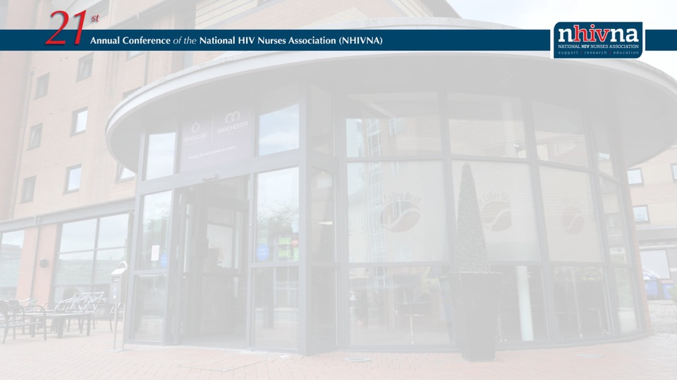
The Language of HIV: a NHIVNA Best practice guide for nurses
Angelina Namiba
Associate Project Manager. Salamander Trust
anamiba15@gmail.com
@angelina_namiba
@4Mproject

Slide 3
Declaration of interests relating to this presentation
None

Slide 4
The Language of HIV: A NHIVNA Best practice guide for nurses
Background
Aim
Some stigmatizing terms
Good Practice – The rules
What nurses need to know
Acknowledgements
Notes:
Talk will cover:

Slide 5
The Language of HIV: A NHIVNA Best practice guide for nurses
Background
Communication: an important part of existence
Language: plays a key role in how we communicate
Verbal & non-verbal communication: Essential in nursing training
Communicating well with patients & colleagues: vital to nursing helps assess, plan and evaluate care
Listening & observing body language complements verbal communication
Notes:
Without communication, it would be difficult for us to exist.
And language plays a key role in how we communicate.
As nurses, verbal & non-verbal communication including language, is an essential part of your training.
The ability to communicate well with patients and colleagues is vital to your work.
It allows you to assess, plan and evaluate care.
Listening to what patients tell and don’t tell you, or observing the nuances of body language communicates more than what we patients verbally tell you.

Slide 6
The Language of HIV: A NHIVNA Best practice guide for nurses
Background
Language matters:
Power to categorise people
Impacts on how we think about ourselves & see others
Has shaped person-centred care
People living with HIV have shaped the language we use & the way we discuss death, dying, sex & sexuality.
Notes:
Language matters and has the power to categorise people in descriptive terms which can be either empowering or reductive.
It impacts on how we think about and see ourselves and others.
Language has also shaped person-centred care and, on the whole many of us people living with HIV have become empowered self-managers, informing the delivery of healthcare services.
Over the past 30 years, we people living with HIV have shaped….
Thereby ensuring that new discourse in the HIV field does not stigmatise but rather catalyses the empowerment of our community members.

Slide 7
The Language of HIV: A NHIVNA Best practice guide for nurses
Background
Discussing HIV & Language is not new
Guidance builds on work done by the CDC;
UNESCO; UNAIDS; Kerr DL & Dilmitis et al…
“We condemn attempts to label us as ‘victims’, a term
which implies defeat, and we are only occasionally
‘patients’, a term which implies passivity, helplessness,
And dependence upon the care of others. We are people
with AIDS”*
*The Denver principles. 1983
Notes:
CDC (Centres for Disease Control and Prevention)
UNESCO (United Nations Scientific & Cultural Organisation)
UNAIDS (The Joint United Nations Programme on HIV & AIDS)
Please note year and use of the term AIDS. The use of this term has evolved since the development & introduction of Highly Active ARVs.
The Denver Principles (for the uninitiated):
1n 1983 just a few weeks after AIDS had been identified, a group of activists met in Denver as part of a gay and lesbian conference.
Little did they know that they were about to something that would change our response to the epidemic, and healthcare in general-forever.
As the conference drew to a close, the activists took it in turn to read a document they had just created themselves, during hours sitting in the hotel’s hospitality suite.
It was their Bill of Rights and Declaration of Independence rolled into one; and it would become known as the Denver Principles. The document begun with the quote above and outlined 17 principles which covered everything from health care decisions, to civil rights to sexual conduct.
These principles became the foundation of GIPA & MIPA – Greater and Meaningful involvement of People living with HIV.

Slide 8
The Language of HIV: A NHIVNA Best practice guide for nurses
Watson S, Namiba A, Lynn V. The language of HIV: a guide for nurses. HIV Nursing 2019; 19(2)
This guidance is aimed at nurses working in HIV, generic nurses and other healthcare professionals.
Notes:
This Best Practice Guide was jointly written and is a collaboration between us three authors.
Huge thank you to my co-authors: Shaun, the dynamic chair of NHIVNA and Vicky who is based at the Florida School of Social Work .
Please share with colleagues and others
This is part of a series of NHIVNA’s Best Guidance Papers and is aimed at nurses working in HIV, generic nurses and HCPs. It is of course a resource that can be used by HCPs outside the HIV sphere.

Slide 9
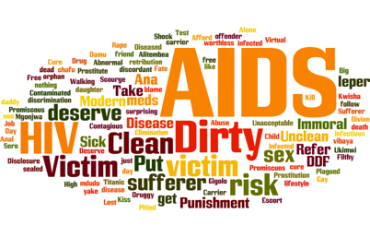
The Language of HIV: A NHIVNA Best practice guide for nurses
Notes:
So why do we keep talking about the Language of HIV?
Well, one of the many reasons is that some of the terminology people use is medically inaccurate, and adds to the myths and stereotypes sorrounding HIV.
Negative terms can further add to the self-stigma for people living with HIV.
30 years into the epidemic, these stigmatizing terms are still being used. Both by people living with HIV and HCPs alike..
For many, it’s not intentional, just language that has been used over the years, however, it can and continues to have an impact on our lives.
These terms, amongst others, continue to fuel stigma, both self and societal.
Word cloud – stigmatizing words used to describe people living with HIV. Facebook mini survey 2016 (some terms in Swahili) note the term AIDS most used.
Google Scholar search April 2019 – using the term ‘full blown AIDS’ revealed 11,000 results.
Limiting the search to the year 2018 revealed 180 results. Now remember, there is no, and never has been, a medical definition for ‘full blown AIDS’
Yet the phrase is still in use today.
As this general search a couple of weeks ago (June 2019), revealed.
So we definitely need to keep talking about & addressing the Language of HIV

Slide 10
The Language of HIV: A NHIVNA Best practice guide for nurses
Rule 1. Positive Words
Focus on using positive words such as ‘Promoting Health’ rather than ‘ending disease’
Instead of | Use
HIV/AIDS | To refer to Virus or Syndrome
Disclosure | Talking/Telling/Sharing
Infection/infectious/infect/ed | Acquire/Transmit/Pass On
Lost to follow-up | Need to find
PLWHIV/PWLH/PWH | People Living with HIV
Notes:
One of the challenges around the use of language is found in academia. Where language focuses on managing, avoiding or eradicating HIV, rather than enhancing health and wellness.

Slide 11
The Language of HIV: A NHIVNA Best Practice guide for nurses
Rule 2. Person first language
Focus on using language that ‘Puts people first’ and acknowledges people living with HIV as fellow human beings
Instead of | Use
Mother to Child transmission | Vertical Transmission
Sero-discordant | Sero-different
Notes:
Mother to Child transmission puts the onus and responsibility of transmission on the mother alone. Blame.
‘Sero-discordant’ implies negativity whereas all the term is trying to describe is the fact that the couple have different HIV status.

Slide 12
The Language of HIV: A NHIVNA Best Practice guide for nurses
Rule 3. Avoid using the language of war
Commonly used by researchers investigation the Possibility of a cure or others to describe how immune cells work…
Instead of | Use
Elimination/Eliminating/shock/ kill | Ending

Slide 13
The Language of HIV: A NHIVNA Best Practice guide for nurses
Good Practice – What Nurses need to know
Keep it kind and simple: Easy to understand medically correct language
Use people-first language: Person before disease
Educate: Challenge misinformation
Think about your audience: Avoid acronyms that may stigmatise

Slide 14
The Language of HIV: A NHIVNA Best Practice guide for nurses
Good Practice – What Nurses need to know
Use empathy: Supportive & sensitive language is critical in our goal to achieve an HIV-free generation and support those living with HIV. Eg when communicating about U=U (=U)
”Using such words or language may result in real or perceived stigma, discrimination, fear and anxiety. Which may prevent some people from getting tested or treated for HIV. We can do our part by being thoughtful when choosing our words and choosing to use supportive rather than stigmatizing – language when talking about HIV.”*
*CDC. Let’s stop HIV together: a guide to talking about HIV. (Accessed April 2019)
Notes:
A good example is when communicating about U=U. Undetectable = Untransmittable. The language we use and the decisions nurses make around how, why and whom to share this message of hope, can have a far reaching impact (both positive and not so positive) depending on how well it is delivered.
The message should go beyond U=U and ideally be Uplifting.

Slide 15

Notes:
Pick up a copy of our guide for more ☺
People living with HIV are leading campaigns aimed at tackling stigma around language.
Use of positive affirming language
A good example is the Positive Affirmation Day – a campaign (set up by my good friend and colleague Mel Rattue) it is focused on redefining the term HIV. PAD happens on the 2nd of December and follows WAD, when HIV is in the spotlight.
However, HIV is still often associated with loss, death and suffering.
Having inspiring statements connected with HIV helps redefine what it means, tackles perceptions and offers an alternative view.
I am Healthy, Intelligent, Vibrant’, declares a status and so much more, it challenges understanding and supports a sense of self-worth and respect.

Slide 16
Notes:
If you are wondering where to start in terms of using positive language:
Here are 144 alternative inspiring statements describing the term HIV, shared by 144 people living with IHV from across the Globe.
When Mel started the campaign just a few years ago, there were only a handful of us willing to use our images publicly on social media.
In order to be inclusive, people can share their statements in any language. As long as they describe the letters HIV.
Now, and I guess largely in connection with the positive affirmation, she has hundreds of people living with HIV across the globe willing to share their positive affirmations, and photographs on social media platforms.
The power of language.

Slide 17
The Language of HIV: A NHIVNA Best Practice guide for nurses
Thank you
Shaun Watson: Clinical Nurse Specialist HIV community, Chelsea and Westminster NHS Trust.
Vickie Lynn: Well Project & School of Social Work, University of Florida, USA
People Living with HIV in all your diversity
Watson S, Namiba A, Lynn V. The language of HIV: a guide for nurses. HIV Nursing 2019; 19(2)
Available free to download from the NHIVNA Website
Notes:
https://www.nhivna.org/NHIVNA-Best-Practice

