Slide 1

Defining Abuse in Assisted Reproductive Technology
Some thoughts from the world of women living with HIV
Alice Welbourn PhD, FRCOG (Hon)
3 June 2019
www.salamandertrust.net
@SalamanderTrust

Slide 2
A definition of abuse from the world of HIV
"Violence against positive women is any act, structure or process in which power is exerted in such a way as to cause physical, sexual, psychological, financial or legal harm to women living with HIV.”
Hale and Vazquez, 2011

Slide 3

Some key ingredients…. examples of where abuse can – and has - occur(red)….
Language
Research
Programmes
Policies
Meaningful Involvement
Funding
Media

Slide 4
🚩 Getting the language right….?

Slide 5



Prongs or pillars? Problems or possibilities?
Prong 1: “Preventing HIV among women of reproductive age”
Prong 2: “Meeting unmet Family Planning needs of women with HIV”
Prong 3 “Preventing HIV transmission to Infants”
Prong 4: “Treatment, care and support for women and families”
Pillar 1: My Health
Pillar 2: My Choice
Pillar 3: My Child
Pillar 4: My Life
From “The Elimination Plan”………….. to “Our SRHR through perinatal care”

Slide 6

🚩 Getting the research right….?

Slide 7
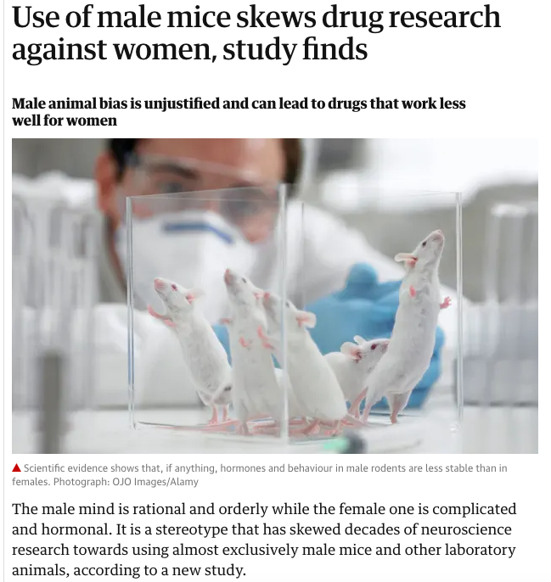
The Guardian 31 May 2019 https://www.theguardian.com/science/2019/may/31/sexist-research-means-drugs-more-tailored-to-men-says-scientist

Slide 8
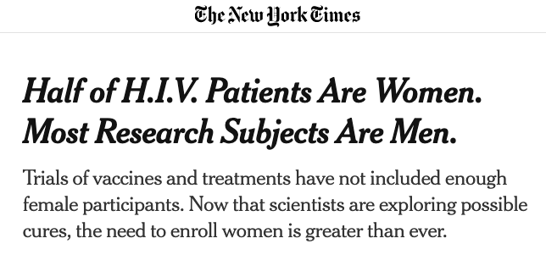
New York Times
28 May 2019
https://www.nytimes.com/2019/05/28/health/women-hiv-trials.html?fbclid=IwAR0r09XYDQXNjnYWNBOEZ8nx2qvFEoITdVPlCLav4HZ1aWOG9uylQkifUZE
“……The response to H.I.V. infection seems also to differ. The immune system in women initially responds forcefully, maintaining tight control over the virus for five to seven years.
But over the long term, this state of high alert takes a toll. Women progress faster to AIDS than infected men, and are more likely to have heart attacks and strokes……”

Slide 9
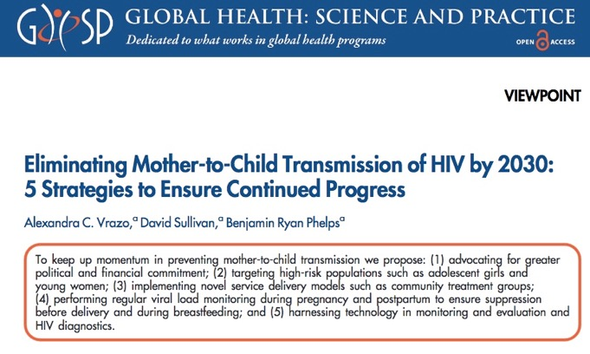
Top-down biomedical language and research from PEPFAR
‘Elimination by 2030’
See more at https://tinyurl.com/SalTICWSatAIDS2018

Slide 10
🚩 Getting the programmes right…. (i) ?
Many examples of violence against women and girls in healthcare settings globally – a huge treatment access barrier
Forced / coerced sterilization – just one example

Slide 11
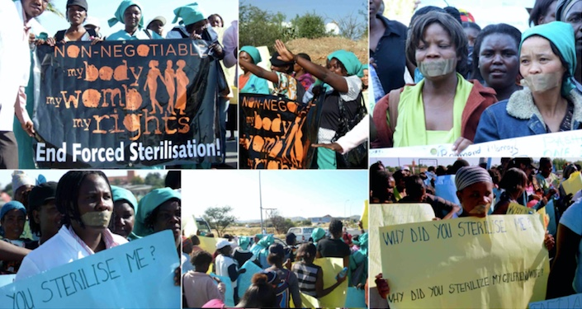


Slide 12
🚩 Getting the programmes right…. (ii) ?
Partner notification
HIV testing of girls
These are examples
of ignoring and
violating rights to
confidentiality and
increasing danger
Notes:
https://static1.squarespace.com/static/5a29b53af9a61e9d04a1cb10/t/5ac3bbaa8a922dc64d9f7bc9/1522777005644/Job+Aids+v2+-+clean.pdf

Slide 13
Getting the policies right……!

Slide 14
Global V&P Survey 2013 - 2015
WHO SRHR Guideline 2017
Checklist 2018

Slide 15

WHO Zero Discrimination in Healthcare 2017
“An effective and integrated health system that is based on the human rights principles of equality and non-discrimination, transparency, accountability and participation is at the heart of the right to health.
As we celebrate Zero Discrimination Day, UNAIDS and WHO are calling for the elimination of discrimination in health care settings which prevents people from accessing and delivering essential health care services.”
Notes:
See http://www.unaids.org/sites/default/files/media_asset/2017ZeroDiscriminationHealthCare.pdf
See also Global Commission on HIV and the Law: https://hivlawcommission.org/wp-content/uploads/2017/06/FinalReport-RisksRightsHealth-EN.pdf
And HIV Justice Network: http://www.hivjustice.net/

Slide 16
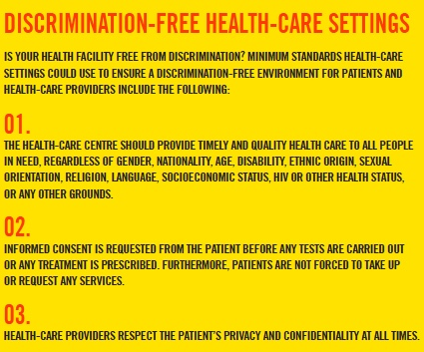
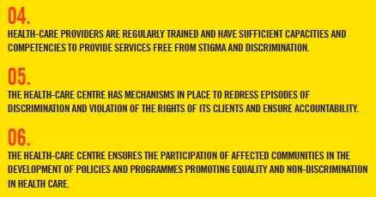
Notes:
Do you feel happy with these standards?

Slide 17

Getting our involvement right……!
  Woman-centred approach
  promotion of human rights
  gender equality
Principles of WHO Sexual & Reproductive Health & Rights Guideline

Slide 18
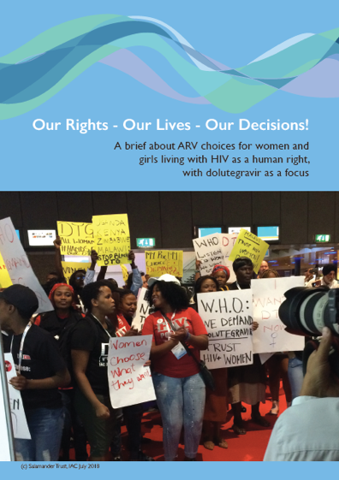
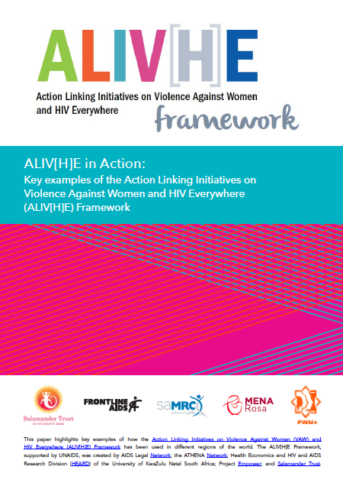
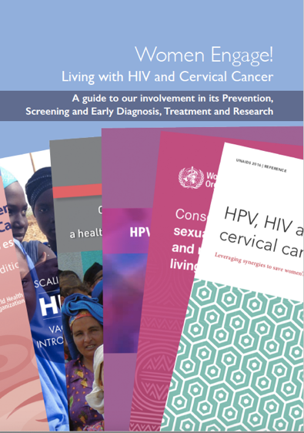

Recent examples of advocacy briefs around our SRHR and our rights to meaningful involvement at all stages

Slide 19
🚩 Getting our funding right……
https://www.theguardian.com/money/2019/apr/07/tampon-tax-women-charities-urge-government-to-ring-fence-cash
Htun M, Weldon S. The Civic Origins of Progressive Policy Change: Combating Violence against Women in Global Perspective, 1975–2005. Am Polit Sci Rev. 2012;106(03):548-569.
AWID 20 years of Shamefully Scarce Funding for Feminists and Women’s Rights Movements 2015 http://www.awid.org/news-and-analysis/20-years-shamefully-scarce-funding-feminists-and-womens-rights-movements

Slide 20
🚩 Getting the media right……
#cheersforsmears

Slide 21
🚩 The way forward….. Getting it right….
Getting the language right
Getting the research right
Getting the programs right
Getting the policies right
Getting our involvement right
Getting the funding right
Getting the media right
Thank you!

