Slide 1

Integrating strategies to address GBV and engage men and boys as partners to advance gender equality through national HIV strategies and plans
16 - 19 September 2013, Dakar, Senegal
UNDP-Nigeria

Slide 2
Introduction
Integrated Programming to Address Gender-Based Violence and Engage Men and Boys to Advance Gender Equality through National Strategic Plans: Country level support to Nigeria
Phase 1- Preparation
Phase 2-Concesus Building
Phase 3-Implententaion
Phase 4 – Monitoring and Evaluation

Slide 3
Phase 1: Preparation
Phase 1: Preparation
• Communicate and consult with the Government of Nigeria, NACA, the Joint UN Teams on AIDS, the UN Gender Working Group, PEPFAR, CSOs and development partners in Nigeria
• Conduct readiness assessment and mapping exercise. Identify key entry points, barriers and capacity needs of policy stakeholders to integrate gender-based violence in HIV responses

Slide 4
Phase 1 : Methodology
Communicate and consult with the Government of Nigeria, NACA, the Joint UN Teams on AIDS, the UN Gender Working Group, PEPFAR, CSOs and development partners in Nigeria .
Organise meetings with the JUNTA, NACA, development partners and CSOs-
One on one meetings with various stakeholders

Slide 5
Phase 1 : Methodology
Conduct readiness assessment and mapping exercise. Identify key entry points, barriers and capacity needs of policy stakeholders to integrate gender-based violence in HIV responses through:
Key informant interview-
Desk review of current policies and practices-
Stakeholder validation workshop
Launch of the report

Slide 6
Where we are on the readiness assessment
A consultant was engaged to carry out the assessment with the main objectives of :
conducting a desk review -to map and assess capacity (structures, mechanisms and processes) that respond to GBV and its intersection with HIV, including mechanisms that support the engagement of men and boys.
2. Conducting a bottle-neck analysis to highlight gaps, potentials, challenges and entry points at various levels

Slide 7

Methodology Readiness and
Mapping Exercise :
Readiness assessment and mapping exercise:
Conducted through review of primary and secondary data
Review of secondary data: identification of Laws, Policies, Conventions and Guidelines that have implications for GBV and HIV
Gathering of primary data from different stakeholders was done through questionnaire with open ended questions
Respondents were purposively selected
Key actors were identified in the 6 geo-political zones of the country and were asked to help identify laws in their regions

Slide 8
Initial key findings of the assessment:
Nigeria has quite a number of GBV related laws – at National and State levels
At the State level the laws are more concentrated in the southern part of the Country
Response to the two epidemics (GBV and HIV) has not been well integrated
Poor coordination of the various components of a comprehensive response to GBV and HIV
Poor linkage between actors responding to the problem e.g. Mirabel Centre & Hello Lagos

Slide 9
Initial key findings of the assessment Cont.:
Lack of Information at different levels – women, girls boys often do not know what to do or where to turn to when they fall victim of abuse
Gaps in knowledge of subject of GBV/HIV among medical, legal and law enforcement agents etc.
No single authority or point of accountability for addressing GBV/HIV link within govt.
Police not well equipped to determine appropriate charges, prepare good court papers & prosecute cases to secure convictions
Many medical personnel, Social Workers are not knowledgeable in this fields and need to be trained

Slide 10
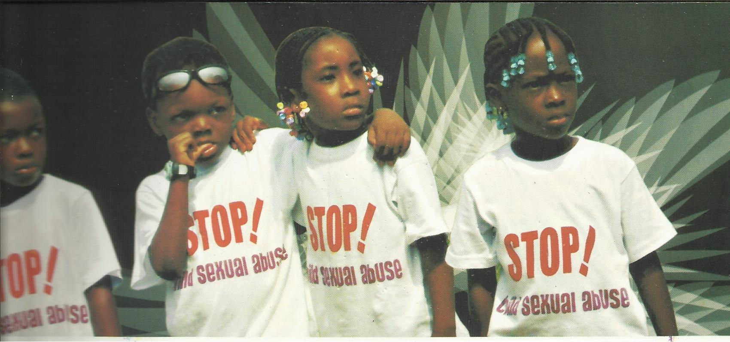
Children in Lagos join the Campaign against Child sexual abuse

Slide 11
lessons learnt and Challenges so far
Bring in the national institution responsible for the NSP at the onset of the exercise
Engage the JUNTA and GTG /DPGG & Dev Partner’s Theme Group on HIV/AIDS
Share as much information as possible with partners –keep them in the loop increasing chances of getting resources to support the programme in future
This type of assessment requires more than one consultant

Slide 12
lessons learnt and Challenges so far
Always engage a consultant who not only has the technical capacity but also has links and networks within the agencies that are likely to take part the assessment process - tel interview?
The methodology could be improved upon – More physical verification and group consultations
Time time time …☺
Slow pace in responding to the questionnaire –this is an on going battle

Slide 13
Other on-going initiatives that might be of interest
UNDP Nigeria has included- A functional Country action plan integrating Gender Based Violence and the engagement of men and boys for better gender equality developed- as one of its agency outcomes in the 2014-2017 UNDAP.
UNFPA Nigeria is currently in the process of developing a training manual for young men on GBV/ASRH
The NSP is currently being reviewed and one key advocacy points UNDP Nigeria has made is to include tackling the issue of GBV and its intersection with HIV
UN –GTG Men Champions against GBV group

Slide 14
THANK YOU !

