Slide 1
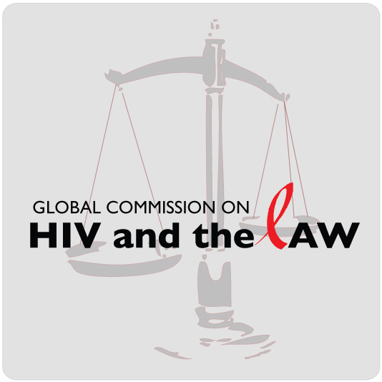
Bechir N’Daw
Regional adviser on human rights and HIV, UNDP

Slide 2
The Global Commission on HIV and the Law
An independent body, established in 2010 at the request of the PCB of UNAIDS and supported by a Secretariat based at UNDP.
The report reflects the views and conclusions of the Commission, as well as its recommendations to countries, civil society actors, the private sector and the United Nations.

Slide 3
The Global Commission on HIV and the Law
Consisted of 14 distinguished individuals who advocate on issues of HIV, public health, law and development. Former President Cardoso of Brazil, chaired the Commission.
Has a unique convening power to focus on high-impact issues of HIV and the law, which have important ramifications for global health and development.
Advocated for evidence and human rights based legal environments for effective and efficient HIV responses.
The life experiences of the Commissioners gave them a formidable ability to access a wide cross-section of society and influence change on complex issues that require the engagement of multiple stakeholders across a range of sectors.

Slide 4
Report “HIV and the Law: Risks, Rights & Health”
The Global Commission on HIV and the Law
undertook 18 months of extensive research,
consultation, analysis and deliberation;
Sources included the testimony of more than
700 people most affected by HIV-related legal
environments from 140 countries;
In addition to expert submissions and the large body of scholarship on HIV, health and the law.

Slide 5
Among the Commission’s findings:
123 countries have legislation to outlaw discrimination based on HIV;
112 legally protect at least some populations based on their vulnerability to HIV. But these laws are often ignored, laxly enforced or aggressively flouted;
In over 60 countries it is a crime to expose another person to HIV or to transmit it;
At least 600 individuals living with HIV in 24 countries have been convicted under HIV-specific or general criminal laws;
Instead, they discourage people from getting tested or treated, in fear of being prosecuted for transmitting HIV

Slide 6
Among the Commission’s findings:
In many countries, the law dehumanizes many of those at highest risk for HIV: sex workers, transgender people, MSM, injecting drug users, prisoners and migrants;
Rather than providing protection, the law renders these “key populations” all the more vulnerable to HIV. Contradictory to international human rights standards, 78 countries make same-sex activity a criminal offence, with penalties ranging from whipping to execution;
Similarly, laws prohibiting—or interpreted by police or courts as prohibiting—gender nonconformity, defined vaguely and broadly, are often cruelly enforced.

Slide 7
Among the Commission’s findings:
Women and girls make up half of the global population of people living with HIV;
Laws and legally condoned customs—from genital mutilation to denial of property rights—produce profound gender inequality;
Domestic violence also robs women and girls of personal power;
These factors undermine women’s and girls’ ability to protect themselves from HIV infection.

Slide 8
Report Recommendations
Offer guidance to governments and international bodies in shaping laws and legal practices that are science and rights-based;
Offer advocacy tools for people living with HIV, civil society, and communities affected by HIV;
Take into account the fact that many laws exist for purposes beyond public health, such as the maintenance of order, public safety;
Place the highest priority on creating legal environments that defend and promote internationally recognized human rights and legal norms.

Slide 9
General Recommendation
Ensure an effective, sustainable response to HIV that is consistent with human rights obligations, the Commission forcefully calls for governments, civil society and international bodies to:
Outlaw all forms of discrimination and violence directed against those who are vulnerable to or living with HIV or are perceived to be HIV positive.
Ensure that existing human rights commitments and constitutional guarantees are enforced.

Slide 10
General Recommendation
Repeal punitive laws and enact laws that facilitate and enable effective responses to HIV prevention, care and treatment services for all who need them.
Enact no laws that explicitly criminalise HIV transmission, exposure or non-disclosure of HIV status, which are counterproductive.
Decriminalize private and consensual adult sexual behaviors, including same-sex sexual acts and voluntary sex work.
Prosecute the perpetrators of sexual violence, including marital rape and rape related to conflict, whether perpetrated against females, males, or transgender people.

Slide 11
Recommendations on MSM
Countries must reform their approach towards sexual diversity. Rather than punishing consenting adults involved in same-sex activity, countries must offer such people access to effective HIV and health services and commodities.
Countries must:
Repeal all laws that criminalize consensual sex between adults of the same sex and/or laws that punish homosexual identity.
Respect existing civil and religious laws and guarantees relating to privacy.
Remove legal, regulatory and administrative barriers to the formation of community organizations by or for gay men, lesbians and/or bisexual people.
Amend anti-discrimination laws expressly to prohibit discrimination based on sexual orientation (as well as gender identity).
Promote effective measures to prevent violence against men who have sex with men.

Slide 12
Recommendations on Sex Work
Countries must reform their approach towards sex work. Rather than punishing consenting adults involved in sex work, countries must ensure safe working conditions and offer sex workers and their clients access to effective HIV and health services and commodities. Countries must:
Repeal laws that prohibit consenting adults to buy or sell sex, as well as laws that otherwise prohibit commercial sex, such as laws against “immoral” earnings, “living off the earnings” of prostitution and brothel-keeping. Complementary legal measures must be taken to ensure safe working conditions to sex workers.
Take all measures to stop police harassment and violence against sex workers.
Prohibit the mandatory HIV and STI testing of sex workers.

Slide 13
Recommendations on Transgender People
Countries must reform their approach towards transgender people. Rather than punishing transgender people, countries must offer transgender people access to effective HIV and health services and commodities as well as repealing all laws that criminalize transgender identity or associated behaviors. Countries must:
Respect existing civil and religious laws and guarantees related to the right to privacy.
Repeal all laws that punish cross-dressing.
Remove legal, regulatory or administrative barriers to the formation of community organizations by or for transgender people.
Amend national anti-discrimination laws to explicitly prohibit discrimination based on gender identity (as well as sexual orientation).
Ensure transgender people are able to have their affirmed gender recognized in identification documents, without the need for prior medical procedures such as sterilization, sex reassignment surgery or hormonal therapy.

Slide 14
General recommendation
The Commission forcefully calls for a renewed and vigorous international collaboration in response to HIV.
It calls on donors, civil society and the UN to hold governments accountable to their human rights commitments;
It urges groups outside government to develop and implement humane, workable HIV-related policies and practices and to fund action on law reform, law enforcement and access to justice;
Educating people about their rights and the law, preventing violence as well as challenging the stigma and discrimination within families, communities and workplaces that continue to feed a worldwide epidemic that should have ended long ago.

