Slide 1
Violence & Vulnerabilities
Addressing GBV & HIV in Humanitarian Settings

Slide 2
Why are emergencies more dangerous?
Exacerbate existing vulnerabilities & inequalities
Females deliberately targeted = increased risk of violence
Lack of necessary health care
Economic vulnerability – including at risk by those delivering aid
More likely to die than males
Disproportionate levels of household burden – including care for people living with HIV
Often at greatest risk of personal & bodily safety

Slide 3
Why do we need to respond?
GBV is a life-threatening protection issue that is magnified in humanitarian emergencies. Sexual violence is the most immediate & dangerous type of GBV occurring in emergencies – affecting women, men, girls, & boys. It is the duty of all humanitarian actors to prevent sexual violence & to provide appropriate assistance to survivors.
GBV intervention is NOT an add-on – it is ESSENTIAL from the beginning of any emergency
Notes:
IASC GBV Guidelines
Emergency & non-emergency services are NOT the same
Emergency services need to be flexible, contextual, adaptive

Slide 4
What core concepts guide our work?
GENDER + GBV + PROTECTION + EMERGENCIES
+ 3 APPROACHES:
  RIGHTS-BASED +
  SURVIVOR-CENTERED +
  COMMUNITY-BASED
+ GUIDING PRINCIPLES
= foundation for GBV programming
in emergencies
Notes:
3 Approaches:
Based on RIGHTS of survivor to have access to best possible care
Survivor decides
Embedded in community – relevant to socio-cultural context
Guiding Principles:
Safety
Confidentiality
Respect
Non-discrimination
In emergencies, women are also:
SURVIVORS who help countries recover more quickly from emergencies
RESILIENT – natural cultivators of social safety nets & community networks
What does this mean for GBV/HIV?

Slide 5
GBV Response
HEALTH
JUSTICE
FAMILY
COMMUNITY
SURVIVOR
PSS
SECURITY
SOCIO-ECON
Notes:
WHAT ARE THE ENTRY POINTS FOR HIV?
Health: Implementing MISP as life-saving starting point for sexual and RH programming & ensuring full post-rape care
PSS: Linking VCT centers with referral system
Security: Recognizing GBV as cause & consequence of HIV status
Justice: Understanding legislation around both GBV & HIV
Socio-economic: Focusing on vulnerabilities when targeting for livelihoods support

Slide 6
What is a referral system?
Support for survivors = MULTI-SECTORAL MODEL
All key sectors + survivor at center
Referral SYSTEM =
Referral NETWORK of service providers & actors +
Referral PATHWAY to explain how survivor might access services

Slide 7
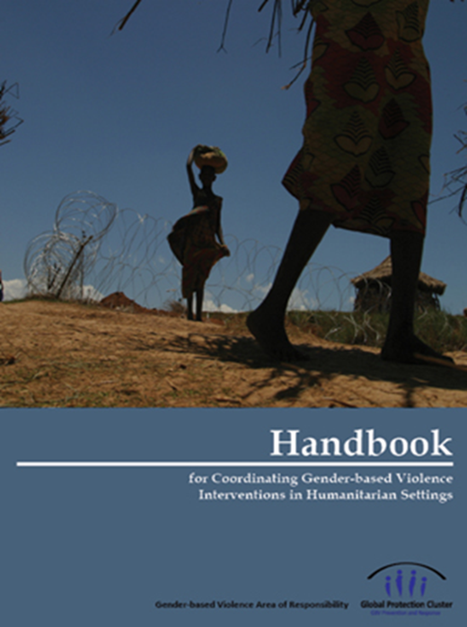
What tool can we use for coordination?
Handbook for Coordinating Gender-based Violence Interventions in Humanitarian Settings
- GBV AoR, 2010
Notes:
WHAT ARE THE ENTRY POINTS FOR HIV?
WHY IS COORDINATION IMPORTANT?!
Work together to provide survivors with full range of care
Mobilize resources
Advocacy
Avoid overlaps & cover gaps
Develop services, systems, & structures to prevent & respond
Integrate GBV prevention & response activities in other sectors
Build on existing mechanisms for sustainability
Enhance what’s working & take it to scale
NB: This is UNDER REVISION
What is it used for?
Good practices for coordination, integration, information-sharing
Emphasizing SV in earliest part of emergency
Guidance on concrete minimum LIFE-SAVING interventions for GBV prevention & response

Slide 8
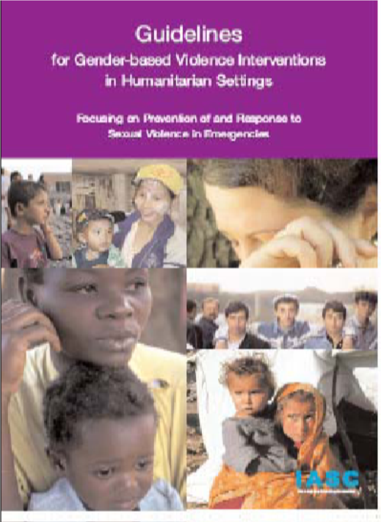
What tool can we use for GBV P&R across sectors?
Guidelines for GBV Interventions in Humanitarian Settings: Focusing on Prevention of & Response to Sexual Violence in Emergencies
– IASC, 2005
Notes:
WHAT ARE THE ENTRY POINTS FOR HIV?
Health sector
MISP
NB: This is UNDER REVISION

Slide 9
What are SOPs?
Specific procedures & agreements among organizations
Plan of action & roles & responsibilities
Minimum standards for prevention & response in emergencies
A process: capacity building + communication + consensus building + partnership building

Slide 10
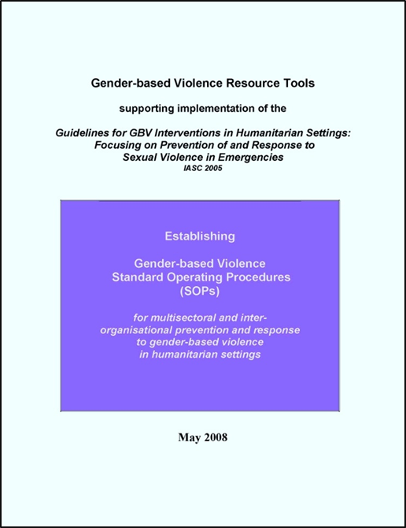
What tool can we use for SOPs?
Guidelines for GBV Interventions in Humanitarian Settings: Focusing on Prevention of & Response to Sexual Violence in Emergencies
– IASC, 2008
Notes:
WHAT ARE THE ENTRY POINTS FOR HIV?
HIV actors are key responders – engage them in referral system to ensure that survivors AND people living with HIV receive best possible care

Slide 11
Why conduct GBV assessments in emergencies?
To better understand situation
To ensure delivery in line with guiding principles
Can also be an intervention
Every question = response relevant to programming = improved services for survivors
NOT to justify action

Slide 12

What tool can we use for assessments?
Ethical & Safety Recommendations for Researching, Documenting, & Monitoring Sexual Violence in Emergencies
– WHO, 2007
Notes:
WHAT ARE THE ENTRY POINTS FOR HIV?
Shared assessments
Asking the right questions
Targeting those who are vulnerable – including people living with HIV

Slide 13
THANK YOU!
~ Lina Abirafeh, PhD ~
Regional Interagency
GBV in Emergencies Advisor
West & Central Africa
IASC GBV Area of Responsibility (AoR)
Rapid Response Team (RRT)
www.gbvaor.net

