Slide 1

Addressing the Linkages Between GBV and HIV: What is out there?
Upala Devi, GBV Advisor, UNFPA
17th September 2013, Dakar

Slide 2
What are the Linkages?
Global studies demonstrate that women living with HIV are more likely to have experienced violence and that woman who have experienced violence are more likely to have HIV.
Violence (or the threat of violence) can increase women and girls’ vulnerability to HIV.
Violence can also be a barrier in accessing HIV prevention, care and treatment services.
Poverty is a major factor: Disempowerment of women makes it more difficult for them to protect themselves from being infected by their partners, exposes them to sexual abuse and rape, limits their access to knowledge about how to protect themselves, and increases the incidence of other STDs that raise susceptibility to HIV infection.
Such a scenario gets exacerbated in conflict, post-conflict and humanitarian settings.

Slide 3
Higher Rates Fuelled by Violence and Gender Inequality – A Vicious Cycle (adapted: Salamander Trust & LS 0f H & TM)
Leads to dependence on male partners, incl. on survival sex
Gender inequality & lower status marginalizes women’s negotiating role in having unprotected sex
HIV infections puts women at further risk - children born are particularly vulnerable
Low/lack of access to quality & safe SRH and HIV services & low awareness further exacerbates stigma & vulnerabilty
Limited opportunities due to lack of access to education & discrimination

Slide 4
Definitions
Violence against women & Gender-Based Violence
Intimate Partner Violence
Women Living with HIV

Slide 5
Violence against Women and Gender-Based Violence
Term used interchangeably but most often, used to denote violence against women and girls
UN GA: 48/104 “Any act of GBV that results in, or is likely to result in physical, sexual or mental harm or suffering, including threats of such acts, coercion or arbitrary deprivation of liberty, whether occurring in public or in private life”
Includes sexual abuse of children, rape, IPV, sexual assault and harassment, trafficking and harmful traditional practices

Slide 6
Intimate Partner Violence
Definition: “actual or threatened physical or sexual violence or psychological and emotional abuse directed towards a spouse, ex-spouse, current or former boyfriend or girlfriend, or current or former dating partner”.
Examples include: slapping, kicking, burning, strangulation (physical); coerced sex through force, threats, intimidation, etc. (sexual); isolation, verbal aggression, humiliation, stalking, economic violence, controlling victim’s access to health care or employment (psychological)
Saltzman et all, 1999

Slide 7
Women Living with HIV
“ Any act, structure or process on which power is exerted in such a way as to cause physical, sexual , psychological, financial or legal harm to women living with HIV”.
Fiona Hale and Marijo Vazquez

Slide 8
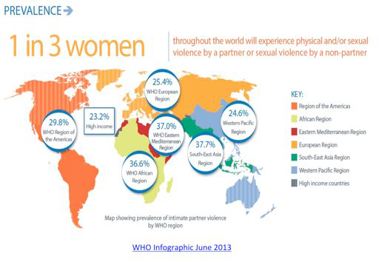

Slide 9
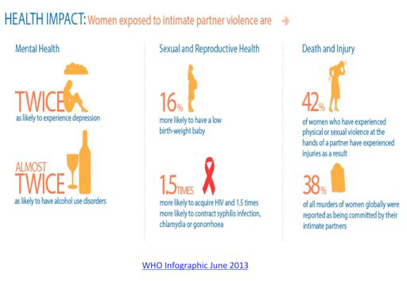

Slide 10
Other Associated Risk Factors (adapted: Salamander Trust and LS of H & TM)
Community Level:
* Lack of social sanction for violence
* Acceptability of wife beating
* Norms supporting male authority as form of control
* Norms of family privacy
Broader Societal Level:
* Lack of eco rights/entitlements for women, incl. to paid employment
* Discriminatory family laws
* Inequality in access to education and other rights
* Much emphasis on “family honor”
Individual and Relationships:
* Childhood abuse, growing up in a violence household
* Alcohol and drugs abuse
* Acceptance of violence
* Less than secondary education for women

Slide 11
Importance of addressing Gender norms
To promote gender-equitable attitudes and behaviors (Gender norms put men in a position of sexual dominance)
Limits women's ability to control their own reproductive and sexual health
Influence on women's health, including women's ability to protect themselves from infection with HIV
To promote gender-equitable relationships between men and women, and reach men with information and services
To change behaviors that place men and their sexual partners at risk of various negative health outcomes
Examples of such norms for men include;
initiating sexual activity early in life
having multiple sexual partners
representing themselves as knowledgeable about sexual matters and disease prevention even when they are not
belief that it is the man's responsibility to acquire condoms, as a young woman who has her own condoms might be seen as promiscuous

Slide 12
contd
Since 2002 the proportion of women living with HIV has increased in every region of the world
In 1990 -1million living with HIV(57% men and 43%women) STRIVE 2013
In 2011- 34million living with HIV (48% men and 52%women) STRIVE 2013
Currently, 11.8% young people aged (15-24) living with HIV (37% men and 63%women)STRIVE 2013
In sub-Saharan Africa 60% of people living with HIV are women.UNICEF 2009
In low and middle-income countries worldwide HIV is the leading cause of deaths and disease amongst women of reproductive age.
Why????????

Slide 13
Key Structural Drivers of HIV
Gender inequality, violence and gender roles encourage male promiscuity, make women vulnerable to violence and restrict their ability to discuss or negotiate sex.
Poverty and limited livelihood opportunities, along with migration, shape patterns of sexual mixing, deplete hope and hinders HIV prevention and treatment efforts.
Stigma and criminalization prevent people from getting HIV testing and hinder the efforts of MSM, sex workers and other marginalized groups to access services;
Unrestricted alcohol availability and drinking norms exacerbate sexual risk-taking and gender-based violence
Empirical evidence strongly links each factor with HIV infection
Notes:
Structural forces – legal, economic and social factors – shape the HIV risk of individuals and populations.

Slide 14
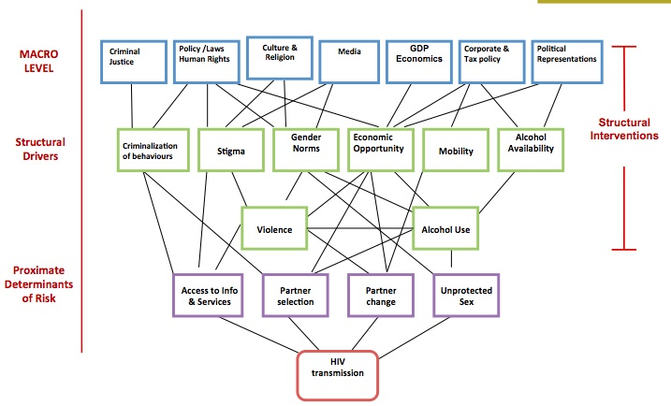
Causal pathways connecting structural drivers
Notes:
Structural forces – legal, economic and social factors – shape the HIV risk of individuals and populations. These factors interact in many different ways to affect behaviours such as choice of sexual partner and use of condoms. These structural factors also undermine treatment and prevention efforts.

Slide 15
Structural Interventions
Gender inequality and violence: Coaching through basket ball and other sports can impact the socialization of boys into men and cultivating gender equality to reduce violence against women.
Poverty and livelihood options: cash transfers and financial training for adolescent girls helps them to stay in school and avoid early marriage.
Stigma and criminalization: Raising awareness about HIV is used as a basis for forming female sex worker collectives which helps women to organize collective action and support
Alcohol: training unlicensed alcohol vendors, bar owners and staff, helps make their venues less conducive to hazardous drinking, violence and sexual risk

Slide 16
How can interventions be designed?
A growing body of well-evaluated, promising programmes already being implemented and that could inform national strategic planning . These fall into various categories, but generally address: gender-equality interventions. For interventions to be sustainable, needs to be incorporated in:
National Strategic Plans on HIV
Poverty Reduction Strategies
UN Common Country Assessments and Development Assistant Frameworks (CCAs & UNDAFs)
National Plans on GBV
National Strategic Plans on Gender
Notes:
1It is now amply demonstrated that programmes aimed at the prevention and treatment of HIV/AIDS cannot succeed without challenging the structures of unequal power relations between men and women. In this regard, an integrated approach needs to be taken to tackle the impact of gender inequality and at the same time, reaching out to the most at risk. National policies and action plans would be vastly more effective if they acted on the inter-connectedness between the two pandemics of HIV and VAW.

Slide 17
Needs to be situated within a broader global compact/framework
1) UNAIDS Agenda
2) CSW 2013
3) UN Security Council Resolutions
4) Post- 2015 Development Agenda

Slide 18
UNAIDS Framework on GE, Women & Girls and HIV/AIDS (2009)
Strengthening capacities of national partners to know their epidemic and response to effectively meet the needs of women and girls
Assisting countries to ensure that national frameworks address the needs of women and girls
Put in place advocacy, CD and mobilization to put in place comprehensive measures to address the needs of women and girls

Slide 19
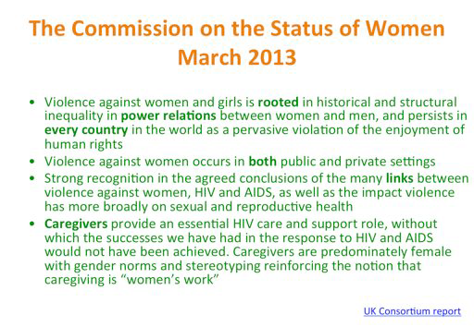

Slide 20
UN SCR 1983
Adopted by the UN SC in June 2011
Deeply concerned that more than 30 years since the pandemic, more than 60 m people infected, more than 25 m dead and more than 16 m children orphaned.
Calls for increased efforts by Member States to address HIV in peace-keeping missions
Also calls for HIV prevention efforts amongst uniformed services to be aligned with efforts to end sexual violence in conflict and post-conflict settings.
Welcomes efforts by Member States for development of sustainable HIV/AIDS prevention, treatment and care, CD and prog. and policy devt. for unformed and civilian personnel to be deployed to UN missions.

Slide 21
Post 2015 processes
Current level of attention to HIV in the post-2015 agenda is inadequate – no renewed focus/commitment to fulfilling promises already made to achieving universal access to HIV prevention, treatment, care and support.
High-level panel of eminent persons on the post-2015 development agenda concludes: “…we must go beyond the MDGs…the did not focus enough on reaching the very poorest and most excluded people”.

Slide 22
National Action Plans and Polices
National Action Plans (NAPs) are overall considered inherently good practice as they are based on one comprehensive plan of action involving a multiple-sector coordinated approach.
There has not been an effort to date to rigorously assess or systematize cross-country and cross-sectoral experiences regarding National Action Plans (NAPs).
Nor does too many NAPs exist that bring address the linkages between HIV and violence.
There is some evidence of Gender Plans that incorporate such linkages: Sierra Leone National Gender Strategy Plan 2010-2013 establishes response mechanisms for GBV survivors (e.g., free medical treatment and legal services) and to strengthening partnerships to reduce women’s vulnerability to HIV. Canada National Plan on HIV/AIDS (2005-2010) recognizes that VAW has a direct impact on their vulnerability.
Some National Action Plans on Security Council Resolutions 1325 and 1820 also focus on addressing SV & HIV in post-conflict settings (Uganda, Sierra Leone, Rwanda & Liberia being cases in point).

Slide 23
National Strategic Plans on HIV
Currently, 164 National Strategic Plans on HIV (source: http://www.aidstar-one.com/focus_areas/prevention/resources/national_strategic_plans)
Africa:61
Asia: 26
Latin America & Carribean: 36
Russia & Eastern Europe: 24
Western Europe: 11
Oceania: 6

Slide 24
Poverty Reduction Strategies
PRSs are becoming the main development planning instruments in many countries, determining national priorities and domestic as well as external resource allocation.
Poverty and powerlessness render women vulnerable to infection. The vicious circle of gender inequality, poverty and “lack of voice” is at the core of the relentless spread of the epidemic.
Strong rationale for integrating HIV/AIDS into PRSs – to ensure that adequate resources are allocated to programmes aimed at reversing the epidemic and managing its impact.
Mainstreaming HIV & AIDS responses in PRSs demonstrate that measurable results have been achieved in reversing the epidemic - Uganda, Senegal, Thailand, Cambodia and Brazil cases in point.

Slide 25
HIV/AIDS responses under UNDAFs: Some Africa Examples
Namibia 2006-2010 UNDAF: Focuses its collective strength on the “Triple Threat” “to contribute to the Government’s efforts to mitigate the impacts of HIV/AIDS, increase household food security and enhance institutional capacities.
Uganda 2006-2010 UNDAF: Individuals, civil society, national and local institutions are empowered and effectively address the HIV and AIDS, with special emphasis on populations at higher risk (Outcome 4).
Zambia 2006-2010 UNDAF : The multi-sectoral response to HIV/AIDS at national, provincial and district level to be scaled up by 2010 (Outcome 1).
Lesotho 2008-2012 UNDAF: Individuals, civil society organizations, national/local public and private institutions have the capacity to achieve/deliver and sustain universal access to HIV prevention, treatment, care and support, and to mitigate its impact (Outcome 1).
Liberia 2008-2012 UNDAF: An additional outcome focuses on HIV/AIDS and has been selected and deemed important due to the potential consequences of the epidemic in Liberia.

