Slide 1

From Concept to Practice – Involving Men and Boys as partners
Alice Welbourn
Salamander Trust
Dakar, Senegal
September 2013

Slide 2
IMPLICATIONS of WHO Option B+ Guidelines on GBV
Safety at home
Safety in healthcare settings
Accountability of healthcare systems to safety of women with HIV
Notes:
This afternoon in this session I would like to share with you information about the Stepping Stones programme, known in French as “parcours”. Let’s just step back a minute. Do you remember yesterday there was talk of the importance of protecting women with HIV from violence in healthcare settings? And do you remember this morning we talked about the dangers of criminalisation for women with HIV in relation to peri-natal transmission? And the issues around forced sterilisation? Well I think we need to start to be far more mindful of such issues in relation to accountability of government ministries of health and other health services in countries. In particular I would like to raise the issue of Option B+, which has just been launched by WHO. This “option” – which is only an option for governments, not for individual women, states that all pregnant women with HIV should go on treatment for life. Well you will see in the film I am about to show you that many women face violence in their communities because of having to go to the health centre to access HIV treatment. We know from other research that such experiences are widespread and not confined to Malawi. So ministries of health – and WHO – need to hold themselves to account to ensure that their programmes are not increasing women’s risk of GBV because of their policies. Please think about this when you watch this film.

Slide 3
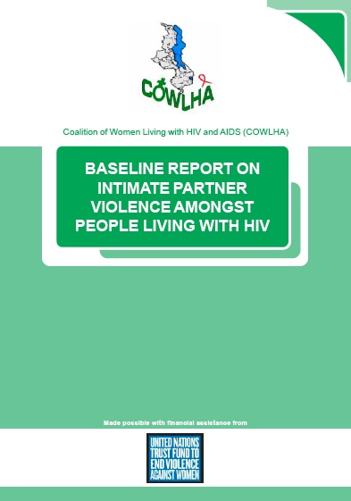
CONSEQUENCIES OF IPV ON COUPLES, HOUSEHOLDS AND OVERALL HIV/ AIDS MANAGEMENT………
Refusal to Continue ART
Inconsistency in following ART
guidelines
3. …….
COWLHA May 2012
Notes:
So moving on to Malawi and the Coalition of Women living with HIV and AIDS. Last year they conducted a baseline survey on intimate partner violence. They learnt from this study that intimate partner violence is widespread amongst its members. They also learnt that when women with HIV face IPV, the first casualty is refusal to continue taking ARTs. They give up the ARTs rather than risk exposure to violence. Secondly, they do not adhere well to treatment. Well as we all know, adherence to this medication is really important. Adherence to any medication is really hard. You know how often people don’t take anti-biotics properly. But you don’t get beaten up for taking anti-biotics. How much harder is it then to be adhering well to medication which will risk violence? No wonder women find it hard to adhere when they are experiencing or fearing this.

Slide 4
Some key ingredients….
✓ Evidence
Scaling-up
MIWA
Engaging Men and Boys as Partners
✓ Empowerment
✓ Enabling Environment
Notes:
So as we look at this film, let’s remind ourselves of some of the key ingredients we have been hearing about over the past two days. These are listed above. COWLHA did their base-line survey and came up with this evidence about intimate partner violence in communities. You will hear that they have scaled up the programme to 12 of 28 districts – and in fact they are now taking it to even more districts. You will see real Meaningful Involvement of Women living with HIV and AIDS in action. You will see that men and boys are involved and engaged there also. You will see what empowerment can look like in a community. And finally you can see how COWLHA have created a real enabling environment in these communities.

Slide 5
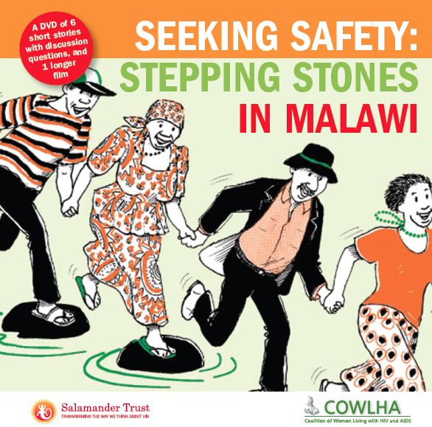
“I used to abuse my wife when she went to the hospital to collect her ARV
treatment because she came back late and I didn’t like it. I stopped the abuse after
COWLHA members came to my house to counsel me that what I was doing was violence"
Notes:
In this film, you will see and hear one of the headmen of the community say the quote above. If someone in his position has this approach it is inevitable that others will also. It is really clear therefore that health services need to recognise and respond to such issues as a part of their programmes. They cannot ethically ignore such issues. Yet so often these policies are being decided without any involvement of women living with HIV. As we saw in the participation tree this morning, many such policies are decided without any meaningful involvement of women with HIV.

Slide 6
COWLHA MALAWI EXAMPLE
“Seeking Safety: Stepping Stones in Malawi”
Notes:
The film can be accessed at the bottom of the following webpage, which explains more about the whole film-making programme with COWLHA: http://tinyurl.com/pxafv34

Slide 7
Stepping Stones history
Uganda
Post-conflict reconstruction (eg Mozambique, Liberia, Angola)
Christian, Muslim, local faith
Rural, urban
Young and old men, young and old women
Key populations: harm reduction, LGBTI, sex work
The Gambia
Notes:
Here is a very brief outline of the history of the Stepping Stones programme, which COWLHA has been using. You can learn more about the whole programme at www.steppingstonesfeedback.org You can also watch a brief film which explains how the programme works here: https://vimeo.com/39882878

Slide 8
EVIDENCE
Randomized Control Trial MRC S. Africa:
WHO, USAID
“What Works for Women”: www.whatworksforwomen.org
Notes:
Now everyone wants to know about evidence of what works in such programmes. Well Stepping Stones had an RCT conducted by the MRC in South Africa and has as a result been recognised by both WHO and USAID as one of the few programmes which reduces GBV in communities. You can read more about all this at the “What Works for Women” website, whose website address is above. (You can enter “Stepping Stones” in the search box there to see more).

Slide 9
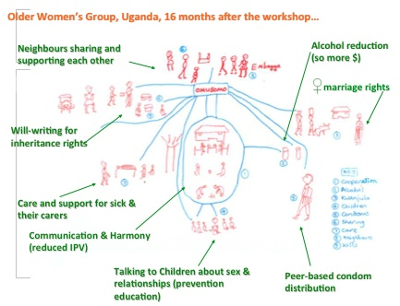
Notes:
Of course, as we said this morning, no evidence really matters unless those most affected by an issue really can feel the difference for themselves. This diagram drawn by older women in a community in Uganda 16 months after the programme finished show the Complex Structural Drivers involved which the programme addresses. These women were just asked “what changes have you seen?” and this is what they responded. They drew their responses because they didn’t have much formal education – but of course they had a deep understanding of what had changed in their lives nonetheless and needed no formal education to benefit from the programme.

Slide 10
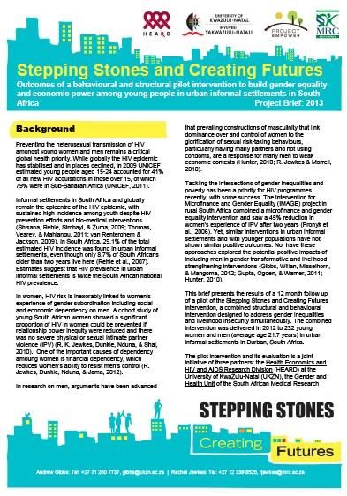
CREATING FUTURES
INCOME FOR YOUNG MEN
AND YOUNG WOMEN UP
“Women reported a statistically significant reduction in their experience of sexual or physical IPV in the past three months”
YOUNG MEN’S MENTAL HEALTH
UP
YOUNG MEN’S
SUICIDAL IDEATION DOWN
Notes:
Finally I want to flag up this great new programme which is a new supplement to the Stepping Stones programme, focusing on livelihoods. Stepping Stones is only a beginning. It’s a springboard for change and a programme like this new “Creating Futures” programme can then really take off. Here on the right you see some of the changes reported in the 12 month post-programme pilot. These changes sound very promising and we hope very much that this programme will be taken up by others after their Stepping Stones programme. More info about “Creating Futures” will be on the memory sticks.
Thank you.

