Slide 1
Introduction:
UNAIDS Agenda for Women and Girls
Susana T. Fried
West and Central africa Regional workshop on gender-based violence, HIV and engaging men and boys as partners for gender equality

Slide 2
Gender Responsive UNAIDS
UNAIDS prioritizes gender equality and human rights as the third pillar of an effective HIV response (UNAIDS 2011-2015 Strategy: getting to Zero).
The UNAIDS Agenda for Women, Girls, Gender Equality and HIV – the operational tool of the Strategy – is being implemented in about 95 countries.
The Strategic Investment Framework recognizes gender equality and gender based violence as both critical enablers and development synergies for an effective HIV response (as per advanced discussions with partners).
.
Notes:
UNDP co-convenes with UNFPA and UNW the UNAIDS working group on meeting the HIV needs of women and girls and addressing gender-based violence. This meeting, as you have heard, is the fourth in a series of consultations to integrate gender-based violence, HIV and the engagement of men and boys into national HIV strategies and plans. The first two meetings in 2010 and 2011 were global convenings, together bringing together country teams from about 30 countries. Last year we convened the first regional workshop, in Johannesburg, for five countries in Eastern and Southern Africa. In each of these meetings we have stressed mobilizing country knowledge and expertise within each country, as well as learning from each other. To that end, for each workshop we have invited one or two countries from the previous workshop to share their experience in moving forward on this agenda. We have also expressed our commitment to providing support for follow up, expressed here through the participation of a member from each country’s UN Joint Team on HIV.

Slide 3
Agenda for Women and Girls
Three Key Recommendations
1. Jointly generate better evidence and increased understanding of the specific needs of women and girls and ensure tailored national AIDS responses (“knowing your epidemic and response”)
2. Translate political commitments into scaled-up action and resources that address the rights and needs of women and girls in the context of HIV
3. Champion leadership for an enabling environment that promotes and protects women’s and girls’ human rights and their empowerment, in the context of HIV
Notes:
August 2009: UNAIDS established a Global Task Force, chaired by EXD and Prof. Sheila Tlou, Botswana
Representing 51 countries and constituencies
Time-compressed process (30 days)
Wide consultation
December 2009: PCB warmly welcomed Operational Plan
March 2010: launch at the 54th meeting of the Commission on the Status of Women.
Countries launching the Agenda for Women and Girls

Slide 4
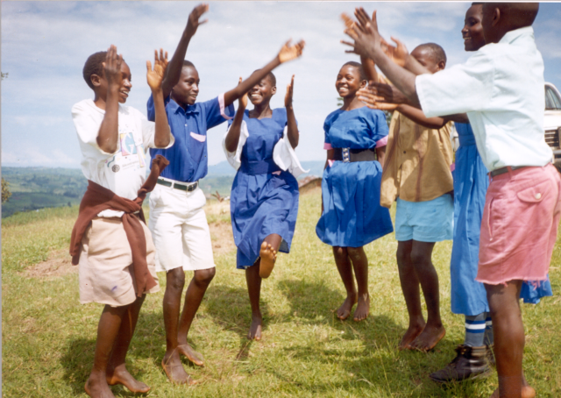
What’s new in the Agenda
Joint consultation process
Menu of 26 action areas – adaptability at country level
Build synergies between the women’s right movement and the AIDS response
Time-bound action areas with measurable deliverables
Within UN Joint Programme of Support
Accountability: progress report to PCB

Slide 5
Findings and recommendations: HIV and VAW
Violence against women and violence against women living with HIV continues with impunity and inadequate laws and law enforcement undermine HIV response.
Recommendations:
  Show zero tolerance for GBV with laws prohibiting violence, full enforcement of laws, and comprehensive and fully resourced national strategies
  Stop the practice of forced abortion and coerced sterilization of WGLHIV as well as all other forms of VAW in healthcare settings

Slide 6
What is the way forward?
Gender transformative HIV responses:
People centred-approaches:
Inclusiveness and equity:
Gender Equality and HIV in action for social change
NSPs and Investment approach
Gender-sensitive budgeting
Harmful gender norms
Tailoring to the gender- specific needs of women, men and transgender populations
Sexual & Reproductive Health
Rights-based approach
End sexual violence
Addressing gender barriers to services
Women and girls living with HIV
Key populations

Slide 7
“Where cultural and traditional legal systems embrace values of dignity and empower women to be equal members of society, women’s vulnerability to HIV is reduced”
(Global Commission on HIV and the Law)

