Slide 1
Integrating gender & GBV into HIV programmes ın Kenya – progress made
Dr Lilian Otiso
Director of Services
Liverpool VCT, Care & Treatment (LVCT)

Slide 2
Key issues – why the drive towards integration
Presentation outline
Background of Kenya
Overview of KNASP
Gaps
Progress made
Moving forward

Slide 3
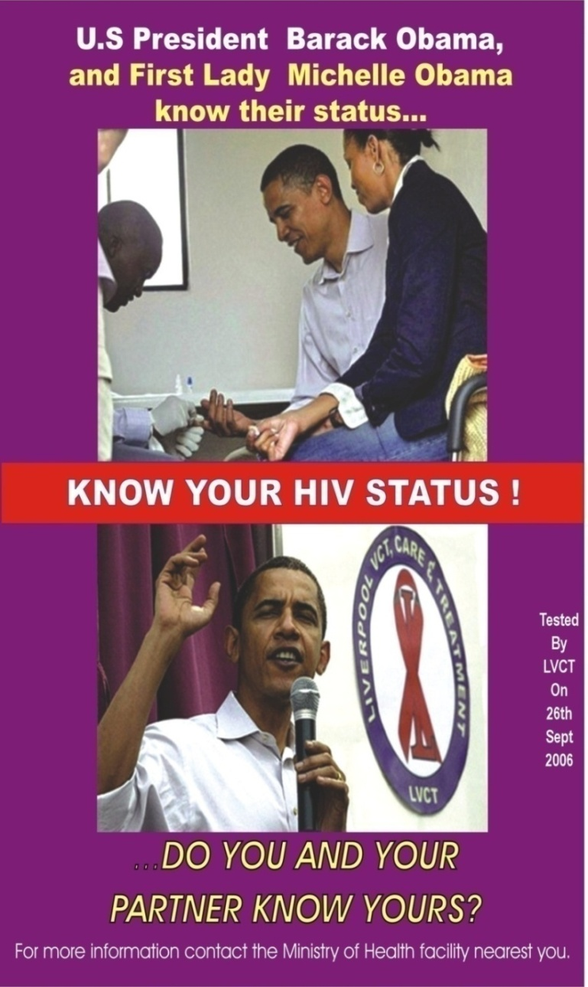
LVCT – an indigenous Kenyan NGO
- country led, country managed, country priorities
1. QA’d HIV testing & counselling
Home based HTC; Mobile; Workplace; Celebrity; >3M tested
HTC as entry for prevention
2. Linking testing to care/ART /SRH
21,000 HIV infected individuals,
Models for effective referrals - TB services, alcohol reduction, supported disclosure, care
E.g. VCT+ model -97% referral uptake
Tracking and retention in care/ART – (community based home f/u; family centres)

Slide 4
LVCT service integration model
3. Vulnerable & at risk populations
MSM/Prisons - 21,000 tested, 121 on Rx
Disability - 20,000 tested, Award winning Deaf VCT sites (women)
Youth - one2one youth hotline PPP with Safaricom (largest telecommunications co. - 30,000 calls); 1.6M tested; 240 on Rx; Sex workers
Gender, Women and Girls
  Gender integration in programmes
  young women (<15yrs)
  vulnerabilities
GBV/Post Rape Care
HIV Testing and Counselling (HTC)
Spot TB Screening
Family Planning Services, lubicants
Alcohol Screening
STI & Cervical Cancer Screening
GBV Information
Effective Referrals

Slide 5
Key issues – why the drive towards integration
Kenya Background
Population – 40m (52% F; 60% youth i.e <35yrs)
HIV prevalence (women 8.4%; men 5.4% of 15 – 64 years)
Highest infections among discordant couples
Burden of care disproportionately affects women
Biological and social vulnerability of women based on age, socio-economic status, marital status, occupations
  Women 15-24 yrs – 4 times more likely to be infected
  Married women at highest risk
  Sex workers – high risk group

Slide 6
Key issues – why the drive towards integration
Kenya Background
Contextual issues –
  IPV, partner alcohol abuse & HIV
  75% of married/cohabitating partners unaware of partner status,
  only 3% use a condom consistently
  30-50% women experience GBV
  10% men experience Sexual Violence as children

Slide 7
Key issues – why the drive towards integration
Kenya National AIDS strategic plan
KNASP: 2009-2013:
multi-sectoral involvement
provides a policy framework to guide integration of issues of Human Rights, gender, GIPA, youth.
Oversight committee ensured integration of above issues – pillar 4 tracks implementation
Currently undergoing mid term review
Evidence on incidence and burden of HIV
KMOT 2007
KAIS 2008
KDHS 2008-9

Slide 8

Research – Kenya’s Modes of Transmission study: where are the women?
Know your epidemic?
generalized epidemic – 44% new infections – couples, MCP
concentrated - key populations
No gender disaggregation
No vulnerability framework
Distribution of new infections by mode of exposures
Blood transfusions
Medical injections
No risk
Steady Partner Heterosexual
Fishing community
Partners CHS
Casual heterosexual sex
Partners of prison population
Prison population (male)
Female partners of MSM
MSM
Partners of migrant farm workers
Partners of truck drivers
Partners of "Other" clients
Migrant farm workers
Long distance truck drivers
"Other" clients
Sex workers
Partners IDU
Injecting Drug Use (IDU)
0
5
10
15
20
25
Percent

Slide 9
National process responses: Gender integration issues/gaps
National response systems and structures
  No deliberate gender expertise in sub/national key committees e.g. ICC advisory, HIV prevention taskforce;;
  Weak health sector coordination e.g. RH, HIV separate
National planning and prioritization
  No accountability for gender analysis in JAPR, in review of scale up of progs e.g couples HTC, PMTCT
Implementing partners
  No capacity for gender integration in planning, prioritization, programming and reporting
Sustained funding for social transformation interventions

Slide 10
‘.. the needs of the married, particularly women have been neglected… despite the fact that more than half of HIV infections in the severe epidemics of ESA are occuring in this group… (Dlevaux 2007)
Gender issues for Programmes - Vulnerability and HIV risk
transmission
transmission
HIV positive 7%
HIV negative, 93%
acquisition
acquisition
  Drivers of sex: Desire to reproduce; pleasure, industry;
  HIV ‘risk’ drivers: vulnerability (Pre-disposition due to biological, social & structural factors where individuals have limited control – e.g. notions of masculinity & femininity, GBV & inability to negotiate safer sex)
  Women’s vulnerability: age, sex, marital status, socio-economic status, occupation (overlay mapping of vulnerabilities & HIV??)

Slide 11
Gender issues for Programmes
Universal access needs to be achieved, but..
Counseling and testing (CT): 56%, but, more women. What is needed for couple uptake (men sexual decision-makers), supported disclosure & links to GBV
PMTCT: focus on WOMEN (MOTHER’s) as Vectors?
Behavior change: homogeneic prevention messaging; access to female condoms; age (girl) friendly services;
VMMC: impact of the protective effect of VMMC on sexual behavior/masculinities – MCRs? Unprotected sex?
Prevention with PLHIV: gender dynamics of disclosure & required skills/services – unknown

Slide 12
Gender issues for Programmes
Universal access needs to be achieved, but..
STIs: Many of women infections are asymptomatic; lack of information; poor linkages btwn services; ltd access
Treatment, care and nutrition: poor access - 300,000 Kenyans (majority of whom are women) not on Rx; service availability at health facilities
TB/HIV services: access and service provider attitudes
OVC: women/girls – disproportionate burden
Transmission in health care settings: 85% throughput is women; HIV PEP - impact on chronic exposures of gender based violence is unknown.

Slide 13
What responses/opportunities currently exist?
What progress has Kenya made

Slide 14
Key issues – why the drive towards integration
Opportunities & Progress made
KNASP recognized
  gender and vulnerable groups
  GBV as part of HIV prevention - GBV now included in PEPFAR and other prevention programs
  Need to engage men and boys
  Research and M&E to provide disaggregated data (age and sex) and analysis – HMIS tools developed and implemented
Gaps
Articulation of systems & structures for monitoring these commitments
Gender analysis and utilization of data
Prioritization and funding of research on gender

Slide 15
Opportunities & progress made
KNASP 3 Mid term review process
  Deliberate, consistent action & monitoring – NACC, the pillars, coordination, prioritization processes,
  identify quick wins within TOWA, NPO, Global Fund applications, JAPR strengthening, pillar evaluations
  Accountability for gender analysis and utilization of vulnerability indicators in national responses
Gaps
Capacity building on utilization of gender analysis & responding to vulnerabilities within
Accountability for results - defined indicators, performance measures, ensuring gender analysis and follow up of recommendations
Notes:
taking forward the UNAIDS action framework

Slide 16
Key issues – why the drive towards integration
Opportunities & Progress made
Practice: Focus on ‘risk’ categorization: - risk is driven by vulnerability- prevention revolution
Prevention interventions that work – PMTCT, Couple HTC, VMMC, Prevention with Positives (PWP); ART; Under testing: Microbicides/ Vaccine/ PEP/PrEP; Treatment as prevention, Women targeted behavioural interventions – EBIs
Gaps
Scale up of bio-medical interventions: to what extent have key gender power dynamics been explored for optimal manipulation to enhance results? PMTCT – focus on WOMEN (MOTHER’s) as Vectors?
Availability of commodities for women – female condoms, lubricants (SW), male condoms
Operationalization of Male involvement

Slide 17
Combination prevention? Integrated services
No single approach is sufficient on its own
Behaviour change at popn level key – but, how do we get there?
Building evidence? Vulnerability framework? Young girls (integrated services addressing gender, GBV and HIV)
HIV Testing and Counselling (HTC)
Spot TB Screening
Family Planning Services, lubicants
Alcohol Screening
STI & Cervical Cancer Screening
GBV Information
Effective Referrals
Biomedical
Interventions
Structural
Interventions
Behavioural Approaches
17
Notes:
17

Slide 18
Opportunities & Progress made
Women and girls living with HIV taskforce convened - taking forward the UNAIDS action framework .
Goal - developing a Gender Mainstreaming Action Plan
To inform national processes including KNASP review
Main thematic areas:
  Capacity Issues
  Leadership and Visibility of WLHIV
  Meaningful engagement of Women & Girls in the HIV/AIDS Response
  Engaging Men and Boys in the National HIV/AIDS response
  Policy and Advocacy Issues
  Partnerships and Networking
  Resource Mobilization, Utilization, Monitoring and Accountability
Notes:
taking forward the UNAIDS action framework

Slide 19
Opportunities & Progress made
GBV Multi-sectoral coordination - health, legal, justice sectors coordination led by SOATF (LVCT and FIDA secretariat support ). Funded by UNTF
Legal reforms - new constitution (bill of rights, women’s rights), SOA & SOATF, anti- FGM bill
  Gaps - Public legal education
  Framework for operationalization (e.g SOA TF since 2006)

Slide 20
Forward directions – Must do
  Long-term funding for social transformation interventions
  Intensified investment in research on gender related aspects within scale up of bio-medical interventions
  Male engagement in interventions delivery
  Increase funding for gender, human rights in programmes, supporting structures and systems, monitoring national frameworks for accountability
  Capacity building on utilization of gender analysis & responding to vulnerabilities within
  Include gender indicators in national and donor M&E e.g. PEPFAR
  Shifting paradigms - Move away from HIV towards issues such as systems strengthening in the context of strengthening integration
  Funding local needs? e.g. 70% of new infections – casual heterosexual sex & couples (primarily women) - funds focus now on MARPs

Slide 21
Thank you!

