Slide 1
INTEGRATING PROGRAMMING TO ADDRESS GENDER-BASED VIOLENCE AND ENGAGE MEN AND BOYS TO CHALLENGE GENDER INEQUALITY IN NATIONAL AIDS STRATEGIES AND PLANS
14-16 November
Istanbul, Turkey
Convened by UNAIDS, UNDP, UNFPA, UNICEF, UNIFEM, WHO and the MenEngage Alliance (Sonke Gender Justice Network and Athena Network ) in close collaboration with the Interagency Working Group on Women, Girls, Gender Equality and HIV

Slide 2
WELCOME!
Co-conveners: UNAIDS, UNDP, UNFPA, UNICEF, UNIFEM, WHO and the MenEngage Alliance (Sonke Gender Justice Network and Athena Network ) in close collaboration with the Interagency Working Group on Women, Girls, Gender Equality and HIV

Slide 3
HIV, GBV and engaging men and boys as partners for gender equality
Commitments – strong but not always matched by practice
Evidence –growing but uneven
Effective programming – expanding array but not always evaluated
Lessons and experience - widening but not always shared

Slide 4
Evidence: global context
Women and girls are disproportionately affected by HIV: 51% of those living with HIV are women and girls
  In Sub-Saharan Africa: 60%
  26% of all new infections occur among girls 15-24
  HIV is the leading cause of death in women of reproductive age
Twin-epidemic of gender-based violence and HIV
  Violence prevalence can be as high as 71%
  South Africa: intimate partner violence increases risk of HIV with 12%

Slide 5
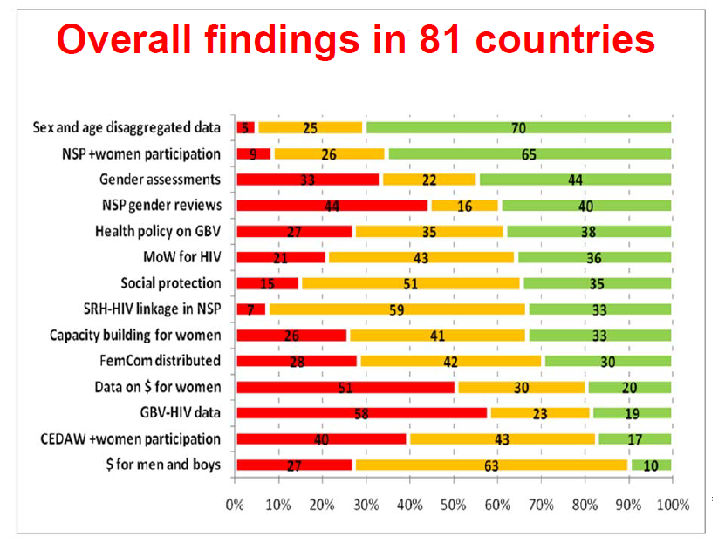
Scorecard on Country Action on Agenda for Women and Girls

Slide 6
Global and regional commitments
An effective framework
  The Millennium Declaration and Development Goals provide a framework for addressing human rights, gender inequality and HIV: gender equality and empowering women (MDG 3), HIV (MDG 6), the strong link between HIV and maternal mortality (MDG 5) and child mortality (MDG 4)
  HLMs
  International and regional human rights norms and standards
Notes:
Emphasizing the importance of building linkages between HIV, sexual and reproductive health and rights policies, programmes and services and efforts to end violence and discrimination against women and girls.

Slide 7
Global and regional commitments: HLM on HIV2011
HLM adopted new Political Declaration on HIV/AIDS with bold goals to be achieved by 2015, including
  Pledged to eliminate gender inequalities and gender-based abuse and violence, increase the capacity of women and adolescent girls to protect themselves from the risk of HIV infection and reiterated the importance of the role of men and boys in achieving gender equality;
  Committed to protect women’s rights and eliminate all forms of discrimination and violence against them
  Called on Member States of the UN to ensure that national HIV/AIDS responses meet specific needs of women and girls, including those living with HIV.
Notes:
30 years since the first reporting of HIV in 1981 - Created significant expectation among governments, civil society and UN to take stock of progress & agree future course
50% reduction of sexual transmission
50% reduction of transmission through injecting drug use
Pledge to eliminate gender inequalities and gender-based abuse and violence, increase
the capacity of women and adolescent girls to protect themselves from the risk of HIV
infection, principally through the provision of health care and services, including,
inter alia, sexual and reproductive health, as well as full access to comprehensive
information and education, ensure that women can exercise their right to have control
over, and decide freely and responsibly on, matters related to their sexuality in order
to increase their ability to protect themselves from HIV infection, including their
sexual and reproductive health, free of coercion, discrimination and violence, and
take all necessary measures to create an enabling environment for the empowerment
of women and strengthen their economic independence, and, in this context, reiterate
the importance of the role of men and boys in achieving gender equality;
Elimination of mother to child transmission and substantial reduction of AIDS-related maternal deaths
15 million PLWHIV on treatment
50% reduction of TB deaths among PLHIV

Slide 8
Commitments on HIV and human rights
Treaties, such as CEDAW Convention (1979), and it GR 15 on HIV/AIDS to guide implementation of appropriate measures.
Global Policy commitments, such as the Cairo Programme of Action from the International Conference on Population and Development (1994) and the Beijing Declaration and Platform for Action from the Fourth World Conference on Women (1995)
Regional commitments, such as:
  The Protocol of the African Charter on Human and Peoples’ Rights on the Rights of Women in Africa (the African Women’s Protocol) (2005)
  Inter-American Convention “Belem do Para” on the Prevention, Punishment and Eradication of Violence Against Women (1994)
Notes:
The African Union’s Declaration on HIV/AIDS, Tuberculosis, Malaria and other Related Infectious Diseases (2003) notes that “the majority of those infected with and affected by HIV/AIDS in our continent are women, children and young people” and the disproportionate burden of care that falls on women and it commits to taking action “in conformity with the principles of equal access and gender equity.” The groundbreaking Protocol of the African Charter on Human and Peoples’ Rights on the Rights of Women in Africa (the African Women’s Protocol) (2005) recalls commitments to the principle of non-discrimination and it heralds equality and non-discrimination as central priorities for HIV prevention and mitigation. There have been several international meetings of heads of state and other leaders who have reaffirmed their commitment to stopping the spread and mitigating the impacts of HIV. Both the Fourth World Conference on Women, also known as the “Beijing” Declaration and the five year review “Beijing+5” brought together government representatives who agreed on the importance of integrating a gender perspective into the HIV/AIDS response. Though not directly speaking on HIV/AIDS, the Convention on the Elimination of all Forms of Discrimination against Women (CEDAW) is another source, in which UN Member States have affirmed the need to “…take appropriate measures to eliminate discrimination against women in the field of health care…” The CEDAW Committee has also released a General Recommendation on HIV/AIDS to guide implementation of appropriate measures.

Slide 9
Policies and strategies
UNAIDS Strategy, Getting to Zero
UNAIDS Agenda for Women and Girls
SG’s Global Strategy on Women’s and Children’s Health
Global Plan on the Elimination of MTCT
UNiTE Campaign
Together for Girls
Cosponsor’s and partners’ strategies

Slide 10
2012-2015: addressing the HIV needs of women and girls and addressing gender-based violence
In line with UNAIDS Strategy, Getting to Zero, Strategic direction 3 (Advance human rights and gender equality), two strategic goals/ functions focusing on gender and HIV:
C3. HIV-specific needs of women and girls are addressed in at least half of all national HIV responses
  HIV strategies and programmes are gender-transformative and appropriately linked with broader country action on gender equality, sexual and reproductive & maternal & child health, and human rights
C4. Zero tolerance for gender-based violence
  National responses integrate GBV and HIV at the policy, programme and services level, including actions and resources that address and prevent both pandemics in an integrated manner
Notes:
Social and legal environments that fail to protect against stigma and discrimination or to facilitate access to HIV programmes continue to block universal access. Countries must make greater efforts: to realize and protect HIV-related human rights, including the rights of women and girls; to implement protective legal environments for people living with HIV and vulnerable populations; and to ensure HIV coverage for the most underserved and vulnerable communities. People living with and vulnerable to HIV should know their HIV-related rights and be supported to mobilize around them. Much greater investment should be made to address the intersections between susceptibility to HIV transmission gender inequality and gender-based violence.
UNAIDS seeks to advance progress towards the vision of zero discrimination by focusing four strategic goals.
Countries with punitive laws and practices around HIV transmission, sex work, drug use or homosexuality that block effective responses reduced by half
Outcomes: what the Joint Programme aims to achieve
Outputs: results of the Joint Programme which contribute to the outcome
Inappropriate criminalization of HIV transmission and legal barriers to HIV service utilization reversed, including attention to specific needs of young people and women
Movements for HIV related law reform are catalyzed and/or supported.
Proposals for law reform or removal of legal/regulatory barriers are approved.
Stigma and discrimination reduced and access to justice increased for people living with HIV and other key populations in all countries
Key populations act as change agents in all countries and in relevant global forums and processes.
Evidence on stigma and discrimination and its impact is developed, updated and used to inform programmes and policies in countries.
Access to legal services and legal literacy increased, especially for key populations, especially on laws and practices which impede universal access to HIV and health services for key populations including women.
HIV-related restrictions on entry, stay and residence eliminated in half of all national HIV responses
Outcomes: what the Joint Programme aims to achieve
Outputs: results of the Joint Programme which contribute to the outcome
Parliamentarians and governments in an increasing number of countries with inappropriate HIV-related travel restrictions are actively considering proposals for reform
National coalitions for relevant law and regulation reform are created including attention to HIV related services for migrants.
HIV-specific needs of women and girls are addressed in at least half of all national HIV responses
Outcomes: what the Joint Programme aims to achieve
Outputs: results of the Joint Programme which contribute to the outcome
HIV strategies and programmes are gender-transformative and appropriately linked with broader country action on gender equality, sexual and reproductive & maternal & child health, and human rights
Strategic actions for women and girls are incorporated into national AIDS strategic plans, with appropriate budgets for implementation, monitoring and evaluation.
Strategic actions on HIV are incorporated into national gender plans, sexual and reproductive & maternal and child health plans, and women’s human rights action frameworks, with appropriate budgets for implementation, monitoring and evaluation.
Social movements that address HIV-specific needs of women and girls catalyzed and strengthened.
Zero tolerance for gender-based violence
Outcomes: what the Joint Programme aims to achieve
Outputs: results of the Joint Programme which contribute to the outcome
National responses integrate GBV and HIV at the policy, programme and services level, including actions and resources that address and prevent both pandemics in an integrated manner
Evidence on GBV/HIV linkages is collected and shared with all countries reviewing or developing national HIV strategies and the range of actors linking GBV and HIV is increased.
Range of actors linking GBV and HIV is increased Evidence on GBV/HIV linkages is collected and shared to all countries reviewing or developing national HIV strategies or GBV strategies.
Countries are implementing a comprehensive set of actions to address and prevent violence against women and girls
Strategies, policies, services, and resource allocation programming within hyper-endemic countries account for HIV prevention, treatment, care and support, gender equality and gender-based violence.
Crisis/post-crisis countries significantly affected by HIV integrate GBV and HIV into conflict prevention, resolution and recovery efforts.

Slide 11
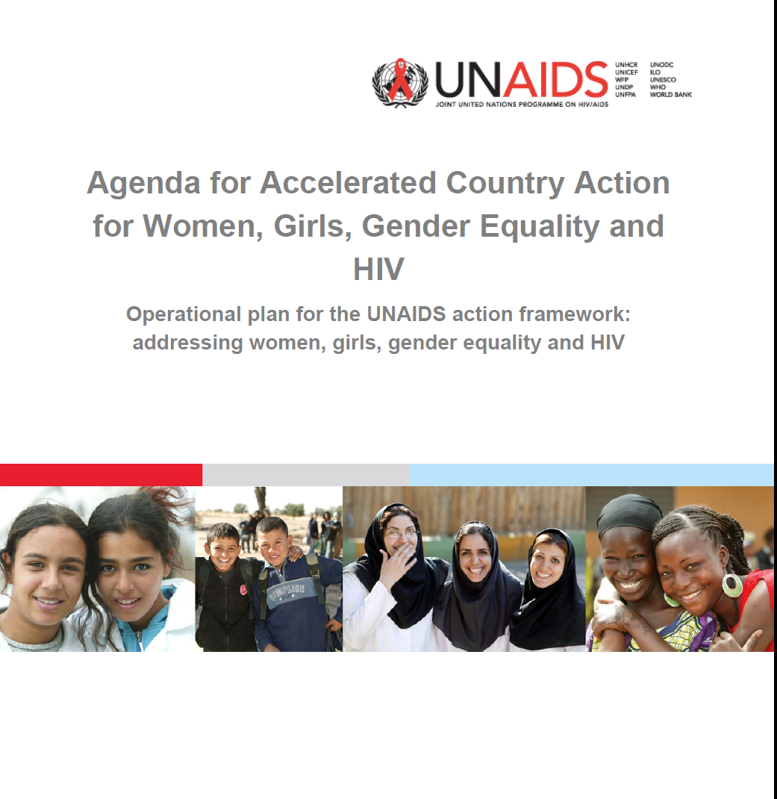
Addressing Women, Girls, Gender Equality and HIV
Notes:
As the lead UNAIDS agency on gender and human rights, UNDP has played a key role in the development of the Action Framework and the Agenda for Accelerated Country Action. UNDP has already started work towards delivering on a number of its key commitments, including: (1) supporting leadership development for HIV positive women and girls in 30 countries, (2) supporting positive women’s networks to increase their participation in MDG reporting, (3) helping countries pay increased attention to HIV in their CEDAW reporting, (4) and initiating “know your rights” campaigns focusing on the rights of women and girls in a number of countries.

Slide 12
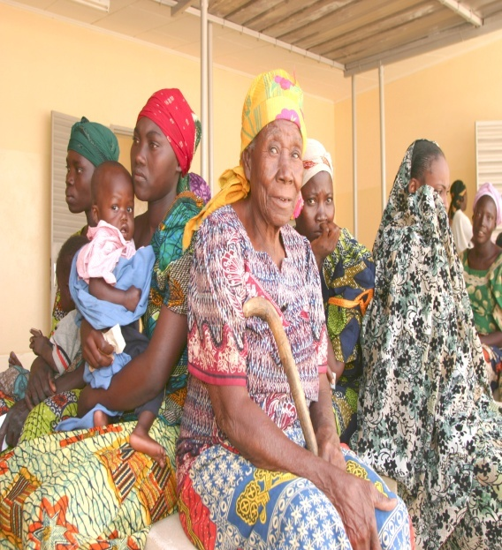
UNAIDS
Action Framework
Issues
Knowing, understanding and responding to the particular and various effects of the HIV epidemic on women and girls
Translating political commitments into scaled-up action to address the rights and needs of women and girls in the context of HIV.
An enabling environment for the fulfillment of the women’s and girls’ human rights and their empowerment, in the context of HIV.
Implementation partners
Global Task Force
UNAIDS family and UNIFEM at all levels
Joint UN Teams on AIDS
Governments
Civil society:
HIV + women’s groups
Other AIDS service organizations
Organizations addressing key populations
ETC.
Notes:
Determines results and assigns responsibilities based on comparative advantage of various actors (UN, donors, governments, civil society)
Assigns 4 tasks to UNDP
First action assigned to UNDP: “UNDP and UNIFEM to advocate and support at least 50% of countries each year, that are due to report to CEDAW according to the four-year reporting cycle, to include in the report quality age and sex disaggregated data on how the HIV epidemic affects women and girls in the report. UN Joint Teams on AIDS to utilize the UNDAF reviews as per country roll-out scheme, to
assess how the epidemic affects women and girls for gender-sensitive UN development assistance programmes.”
Second action assigned to UNDP: “UNDP to support at least two national networks of women living with HIV per region to map and assess progress on international gender equality and women’s and girls’ human rights commitments, as input to the 2010 UN Millennium Development Goals Summit.”
Third action assigned to UNDP: “UNDP to support the eight “Delivering as One” countries to launch “know your rights” campaigns, and support the provision of free and accessible legal aid services, and the establishment or strengthening of existing fora for the enforcement of rights, by end 2010, with subsequent annual roll-out of at least two countries per region.” (Albania, Cape Verde, Mozambique, Pakistan, Rwanda, Tanzania, Uruguay, and Viet Nam)
Fourth action assigned to UNDP: “UNDP to take the lead in the UN Joint Teams on AIDS to support leadership development programmes for women, young women and girls living with HIV in 30 countries by end-2010 and 20 countries by the end of 2011, due to develop new national AIDS strategies.”

Slide 13
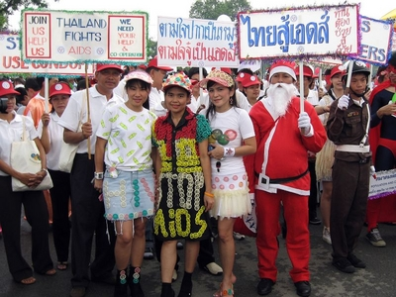
UNDP/UNAIDS: Global Commission on HIV and the Law
Four focus areas
* Laws and practices that mitigate or sustain violence and discrimination as lived by women.
*Laws and practices that effectively criminalise people living with HIV and vulnerable to HIV (including women living with HIV and female sex workers)
*Laws and practices that facilitate or impede HIV-related treatment access (including attention to gender-specific issues)
*Issues of law and HIV pertaining to children (including attention to both girls and boys).
findings and recommendations are expected in the first quarter of 2012.
Notes:
UNDP and the UNAIDS family are supporting a Global Commission on HIV and the Law to address some of the most challenging legal issues in the context of HIV, including how legal frameworks affect discrimination and violence against women and girls in the context of HIV
Develop actionable, evidence-informed, human rights-based recommendations for effective HIV responses that promote and protect human rights of people living with and most vulnerable to HIV.
Regional Dialogues with affected communities and law and policy-makers to ensure broadest possible representation of communities and issues.
The UNDP-led Global Commission on HIV and the Law is an 18-month initiative supported by UNAIDS with the goal of developing actionable, evidence-informed, human rights-based recommendations for effective HIV responses that promote and protect the human rights of people living with and most vulnerable to HIV. The Commission comprises three mutually reinforcing axes: a high level commission that will add insight and weight to findings and recommendations, a Technical Advisory Group and associated research activities to generate and build consensus around the evidence base, and Regional Dialogues with affected communities and law and policy-makers to ensure appropriate regionalization and the broadest possible representation of vulnerable communities and urgent issues.. Dialogues have already been held in Asia Pacific, the Caribbean and Eastern Europe and Central Asia. In the next few months, additionaldialogues will be convened in Latin America, Africa, Middle East and North Africa and High Income Countries.
The Commission is focusing on four areas, one of which is is laws and practices that mitigate or sustain violence and discrimination as lived by women. The other three are:
(1) Laws and practices that effectively criminalise people living with HIV and vulnerable to HIV (including women living with HIV and female sex workers)
(3) Laws and practices that facilitate or impede HIV-related treatment access (including attention to gender-specific issues); and
(4) Issues of law and HIV pertaining to children (including attention to both girls and boys – are we doing anything specific with intersex/trans kids?).
The fifteen-member Global Commission on HIV and the Law is chaired by Fernando Henrique Cardoso, the former President of Brazil, and it is currently holding regional dialogues around the world to better understand and prioritize relevant issues. The Commission’s findings and recommendations are expected in the first quarter of 2012. When these are released, UNDP will share them with the Working Group and would welcome the opportunity to engage in further dialogue with this group on how the work of the Commission can be used to support the Working Group’s execution of its mandate. This seems to me to take away from the prominence of the Commissioners – is there a reason it has to be said this way? Couldn’t we say “will consider the evidence and present findings.”
You need a bit more here laying out some of the issues or the range of issues that this will encompass – especially since most of the folks are women’s rights/human rights folks without much HIV knowledge)

Slide 14
Goals of workshop
Strengthen attention to gender-based violence in NSPs for a more effective national response.
Develop and operationalize strategies that engage men and boys in transforming gender norms
By:
  Expanding linkages among key partners: the UN, bilateral donors, national governments and civil society
  Building effective partnerships at the national level develop and implement a comprehensive response to gender –based violence and strengthen capacity to engage men and boys for gender equality.
Notes:
To strengthen attention to gender-based violence in national strategic plans on HIV and AIDS, bringing together multi-sectoral teams from seven priority countries.
To develop and operationalize strategies that engage men and boys in transforming social norms related to gender and sexual relationships, including representatives of an additional three countries per region from five regions.
Emphasis will be placed on:
Aligning and linking the efforts of the UN, bilateral donors, national governments and civil society; and
Building effective partnerships at the national level with both existing and new partners in order to integrate a comprehensive response to violence against women and girls into national AIDS strategies and plans and to strengthen capacity to engage men and boys for gender equality.

Slide 15
Objectives
Identify policy and programmatic responses to GBV/HIV intersections and recognize gender-based violence as both a cause and consequence of HIV transmission.
Advance the strategy of engaging men and boys as partners as a means of advancing gender equality and halt the gender-based violence-leads-to-HIV-leads-to-gender-based violence cycle.
Assess strengths, weaknesses, and gaps in addressing gender-based violence as a cause and consequence of HIV, and the engagement of men and boys
Define country-level actions plans to strengthen integration
Notes:
Identify specific policy and programmatic responses to the intersections between HIV and gender-based violence at different points along the HIV prevention, treatment, care and support continuum, and recognize gender-based violence as both a cause and consequence of HIV transmission.
Advance the strategy of engaging men and boys as partners as a means of advancing gender equality and as a key intervention to interrupt and halt the gender-based violence-leads-to-HIV-leads-to-gender-based violence cycle.
Review existing National Strategic Plans on HIV and AIDS to assess strengths, weaknesses, and gaps in addressing gender-based violence as a cause and consequence of HIV, and the engagement of men and boys as a core strategy for transforming gender norms which underpin unequal gender relations, including gender-based violence.
Define country-level actions plans to strengthen the integration of strategies to address gender-based violence and to engage men and boys for gender equality into National Strategic Plans on HIV and AIDS, and other national policies, plans and processes, as appropriate.
Anticipated Outputs
Consensus and understanding regarding the mutually reinforcing cycle of gender-based-violence and HIV, and the potential role of engaging men and boys for gender equality to interrupt and halt this cycle and strengthen the national AIDS response.
Analysis of existing country plans.
Country level action plans to support the integration attention to gender-based violence, and the engagement of men and boys for gender equality, in National Strategic Plans on HIV and AIDS and other national policies and plans, as appropriate.

Slide 16
Anticipated Outputs
Consensus and understanding regarding the mutually reinforcing cycle of gender-based-violence and HIV, and the potential role of engaging men and boys for gender equality to interrupt and halt this cycle and strengthen the national AIDS response.
Analysis of existing country plans.
Country level action plans to support the integration attention to gender-based violence, and the engagement of men and boys for gender equality, in National Strategic Plans on HIV and AIDS and other national policies and plans, as appropriate.

