Slide 2
Key Strategies:
No. 3 - Ensuring the meaningful participation of women living with HIV in the NSP development process, and ensure that the rights (including SRH Rights) of women living with HIV are appropriately represented in NSPs

Slide 3
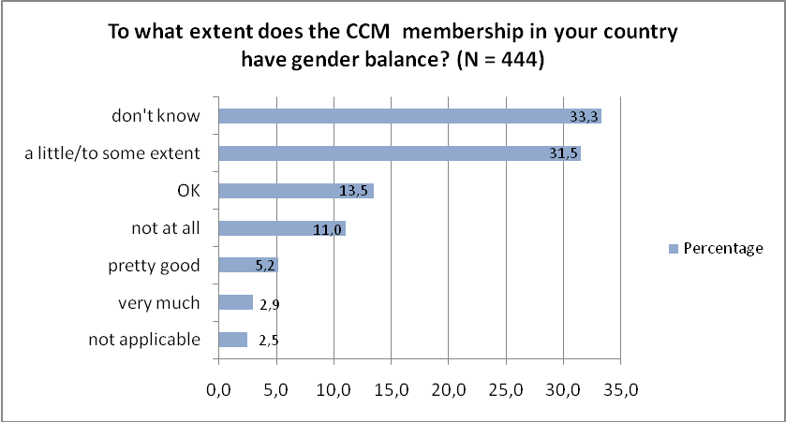
Source: FEIM/IAWC/GCWA GFATM Gender Equality Survey 2011: Fig. 10

Slide 4
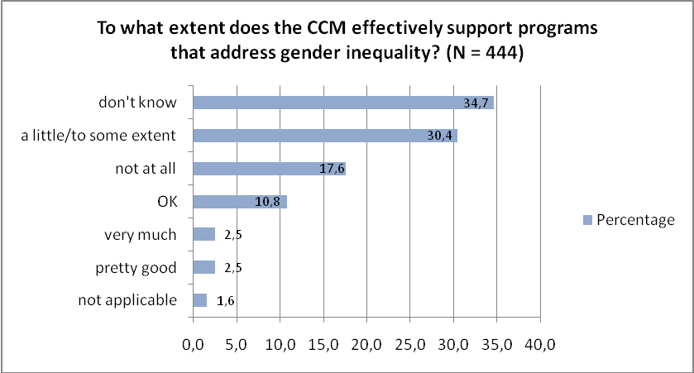
Source: FEIM/IAWC/GCWA GFATM Gender Equality Survey 2011: Fig. 11

Slide 5
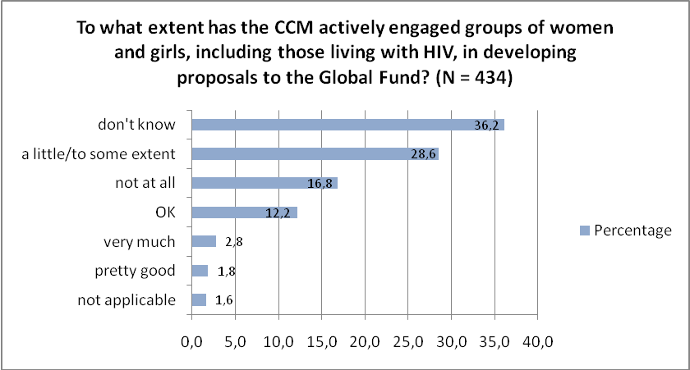
Source: FEIM/IAWC/GCWA GFATM Gender Equality Survey 2011: Fig. 12

Slide 6
GFATM CCM representatives:
(spreadsheet…)

Slide 9
http://www.womeneurope.net/index.php/page/Policy_Brief_2011/en

Slide 11
Table-based discussions:
Women living with HIV as your resource persons: GBV, engagement of men, your NSPs
(5 mins)
Examine the policy brief: 60 networks of women living with HIV globally – how can our requests be addressed through your NSP?
(20 mins)

