Slide 1
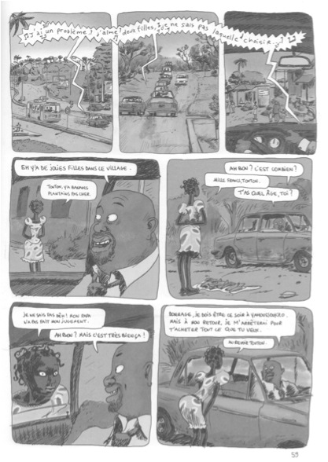
GBV & HIV, What about the Adolescent & Young populations? Abdelkader BACHA UNICEF
Notes:
Category B: Questions:
Can these interventions per se be effective?
If so:
What specific things need to be done to ensure adolescents receive these interventions effectively?
How best to design and implement them for maximum cost-effectiveness among adolescents?
For example, how to get sexually exploited adolescents engaged in sex work to test for HIV, to be started on HAART (if indicated), retained in care, and to adhere to treatment?
Category A:
Questions:
What specific things need to be done to ensure adolescents receive these interventions effectively (eg. effective access, and, where necessary, retention & adherence)?
For example, how to get adolescents to test for HIV, to be retained in care, and to adhere to treatment?

Slide 2
Regional snapshot
A quick look into the cross-country profile
(Excel spreadsheet)
Notes:
Category B: Questions:
Can these interventions per se be effective?
If so:
What specific things need to be done to ensure adolescents receive these interventions effectively?
How best to design and implement them for maximum cost-effectiveness among adolescents?
For example, how to get sexually exploited adolescents engaged in sex work to test for HIV, to be started on HAART (if indicated), retained in care, and to adhere to treatment?
Category A:
Questions:
What specific things need to be done to ensure adolescents receive these interventions effectively (eg. effective access, and, where necessary, retention & adherence)?
For example, how to get adolescents to test for HIV, to be retained in care, and to adhere to treatment?

Slide 3
GBV & HIV: The Continuum
GBV (frequently justified, social and cultural factors) >> Vulnerability >> HIV >> Precarity >> GBV
Women’s rights
SRHR linkages
In our region: FGM (Guinee, Mali, Gambia..); Early Pregnancy
GBV including sexual violence drives the epidemic
Story from Senegal: Anna, raped by her stepfather, abused by her boy friend, sex work as a survival strategy, HIV, exclusion.
Notes:
Category B: Questions:
Can these interventions per se be effective?
If so:
What specific things need to be done to ensure adolescents receive these interventions effectively?
How best to design and implement them for maximum cost-effectiveness among adolescents?
For example, how to get sexually exploited adolescents engaged in sex work to test for HIV, to be started on HAART (if indicated), retained in care, and to adhere to treatment?
Category A:
Questions:
What specific things need to be done to ensure adolescents receive these interventions effectively (eg. effective access, and, where necessary, retention & adherence)?
For example, how to get adolescents to test for HIV, to be retained in care, and to adhere to treatment?

Slide 4
GBV & Unstable situations
GBV and sexual violence in conflict situations:
Central African Republic (huge number of rapes and cases of violence);
Mali, Cote d'Ivoire like before in Sierra Leone and Liberia (women used as war weapons, rapes during the conflict, pregnant girls)
GBV and emergency (natural disasters > Displaced populations > Precarity > Sex for survival > Problems of access to prevention services and commodities/condoms..)
➔ ADOLESCENTS, PARTICULARLY GIRLS: EASY VICTIMS!
Notes:
Category B: Questions:
Can these interventions per se be effective?
If so:
What specific things need to be done to ensure adolescents receive these interventions effectively?
How best to design and implement them for maximum cost-effectiveness among adolescents?
For example, how to get sexually exploited adolescents engaged in sex work to test for HIV, to be started on HAART (if indicated), retained in care, and to adhere to treatment?
Category A:
Questions:
What specific things need to be done to ensure adolescents receive these interventions effectively (eg. effective access, and, where necessary, retention & adherence)?
For example, how to get adolescents to test for HIV, to be retained in care, and to adhere to treatment?

Slide 5
Priorities for Adolescents Programming Based on the Investment Approach
Adolescent
Girls
Key
Populations
ALHIV
Strengthen political accountability, technical capacity and allocation of resources to expand access to high impact prevention, treatment and care interventions for adolescents in these three groups.
Work with adolescents and young people to identify and address legal and policy barriers that limit access and utilization of interventions of proven efficacy as well as social norms that increase vulnerability;
Strengthen systems for monitoring, tracking, and reporting on service delivery as well as broader health outcomes in adolescents.

Slide 6
What has worked in other countries
Knowledge generation on young people and in adolescents-
CDI- Vulnerability study
Nigeria- review of existing studies on Adol and young people; ALVIH study
Cameroon and CAR- Vulnerability Study
Guinea Bissau- Secondary analysis of risk factors in young people and adolescents
Knowledge and behaviors change- Shuga Radio Programme- DRC, Cameroon, Kenya
School based education programme- Ghana, Nigeria
Nationwide programme- NYSC in Nigeria

Slide 7
➔ To think about…
Increasing Concern in the region: Adolescent among the Key Populations (SW, MSM, PUD) >> The Most Vulnerable. Friendly and appropriate Services??
Ensure particular focus on key populations, in both stable and unstable situations
Sex workers and the police
Transgender
Focus on girls and adolescents
Stories of resilience and positive involvement
Shuga Radio (DRC, Cameroon)
Mandate that policy makers have to do this globally (Links to UNAIDS Agenda and SIF: the 6 key interventions and the Community Mobilisation as critical enabler)
Notes:
Category B: Questions:
Can these interventions per se be effective?
If so:
What specific things need to be done to ensure adolescents receive these interventions effectively?
How best to design and implement them for maximum cost-effectiveness among adolescents?
For example, how to get sexually exploited adolescents engaged in sex work to test for HIV, to be started on HAART (if indicated), retained in care, and to adhere to treatment?
Category A:
Questions:
What specific things need to be done to ensure adolescents receive these interventions effectively (eg. effective access, and, where necessary, retention & adherence)?
For example, how to get adolescents to test for HIV, to be retained in care, and to adhere to treatment?

Slide 8
AYA DE YOPOUGON (Bande dessinee populaire en Cote d’Ivoire)
Notes:
Category B: Questions:
Can these interventions per se be effective?
If so:
What specific things need to be done to ensure adolescents receive these interventions effectively?
How best to design and implement them for maximum cost-effectiveness among adolescents?
For example, how to get sexually exploited adolescents engaged in sex work to test for HIV, to be started on HAART (if indicated), retained in care, and to adhere to treatment?
Category A:
Questions:
What specific things need to be done to ensure adolescents receive these interventions effectively (eg. effective access, and, where necessary, retention & adherence)?
For example, how to get adolescents to test for HIV, to be retained in care, and to adhere to treatment?

Slide 9
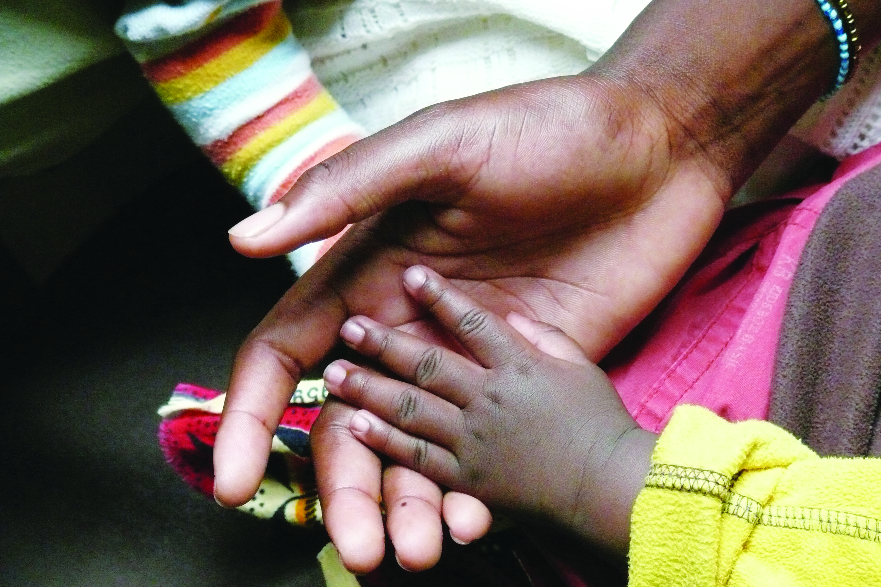
“Let’s Be the Change We Want to See in the World” Mahatma Ghandi

