Slide 1
Together for Girls – a focus on national evidence collection and response frameworks
UNICEF, 2012

Slide 2
TfG - What is it?
A global initiative of multilateral, government and private sector partners (CDC, WHO, UNICEF, UNAIDS, UNFPA, UN WOMEN, USAID, Nduna Foundation…) to end sexual violence against girls
Activities include support to:
National surveys and data
Coordinated programmes
Global advocacy and awareness

Slide 3
Where?
Africa (Kenya, Malawi, Swaziland, Tanzania, Zimbabwe)
East Asia and the Pacific
Latin America and the Caribbean (Haiti)

Slide 4
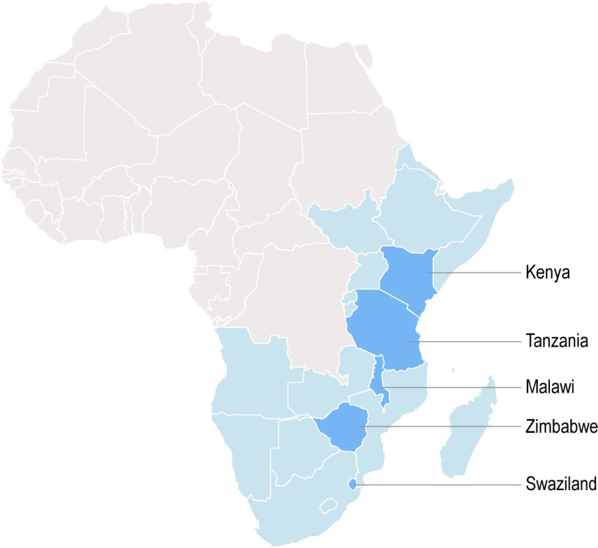
Violence against Children Surveys:
2007-2013
Notes:
Focusing in on Africa, TfG has supported a number of important national prevalence surveys (randomised household cluster surveys) in 5 countries in Africa to date. These are surveys led by UNICEF, inpartnership with CDC and Governments, to document national prevalence and incidence of violence against children (physical, emotional, sexual)

Slide 5
A snapshot from Tanzania
Notes:
Here is an example of the findings published by the Government of Tanzania in 2012 – note the prevalence of sexual violence amongst girls, which correlates (approximately) to levels documented in similar surveys in Zimbabwe, Swaziland and Kenya.
Physical Violence Girls 73.5 Boys 71.7 -
Emotional Violence Girls 23.6 Boys 27.5 - Most victims of emotional violence also experienced physical violence

Slide 6
Notes:
These surveys also tell us more about where and by whom the violence is perpetrated. And here we do see some striking differences between countries.

Slide 7
Zimbabwe NBSLEA May 2012
Notes:
A snapshot from Zimbabwe with an emphasis on the need for universal service access (free, unconditional, quality)

Slide 8
Common findings
Prevalence of sexual violence amongst adolescent girls (25 -35%)
Majority of survivors are victims of child abuse (75-85%)
Perpetrators are known (neighbours, family, partners)
Absent or failing service provision and access (2 -12%)
Survivors more likely to engage in risky HIV behaviours

Slide 9
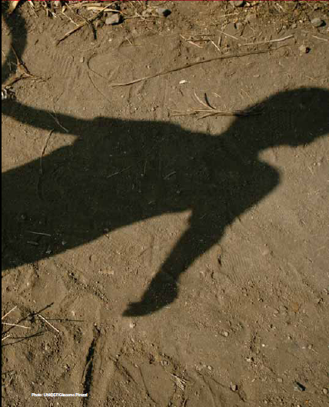
From Survey to Response
VAC Surveys introduce new oppportunities for partnerships, funding, focus and innovation
Response Plans usually multivariate in nature to address hyper-epidemic contexts characterised by poverty, HIV and gender inequality
Highlights:
Age and context sensitive responses (e.g. focus on young adolescents)
Costed
Targeted
Linked to other national strategies, policies and laws (gender, HIV, GBV, social protection)

Slide 10
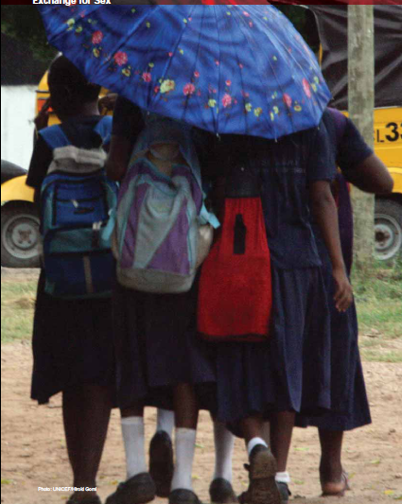
Challenges
Politically sensitive
Multi-sectoral and complex
Funding
Ethical and meaningful involvement of survivors
VAC
Gender equality strategy
GBV Action Plan
OVC Action Plan
Poverty Reduction Strategy
HIV Strategic Plan

Slide 11
And 2 questions
What is the cost? Cost benefit and cost effectiveness data is still limited – TNZ/ Zim/ HQ developing model for testing
What works to support girls and boys in their transition to adulthood? Pilots – national scale programmes with robust M+E required
Notes:
Adolescent programming critical as an investment for countries and development partners but efforts are largely small scale and undocumented – new models emerging, however in economic empowerment and social norms programming however

